Slide 1
Integrated Solid Waste Management Kutaisi – Annual review of project achievements 2016 - 2017
Second Journalist Meeting in Kutaisi -
13 September 2017

Slide 2
Main topics
Waste Management System in Georgia – now and then
The new landfill for Imereti, Racha-Lechkhumi and Kvemo Svaneti
Project activities

Slide 3
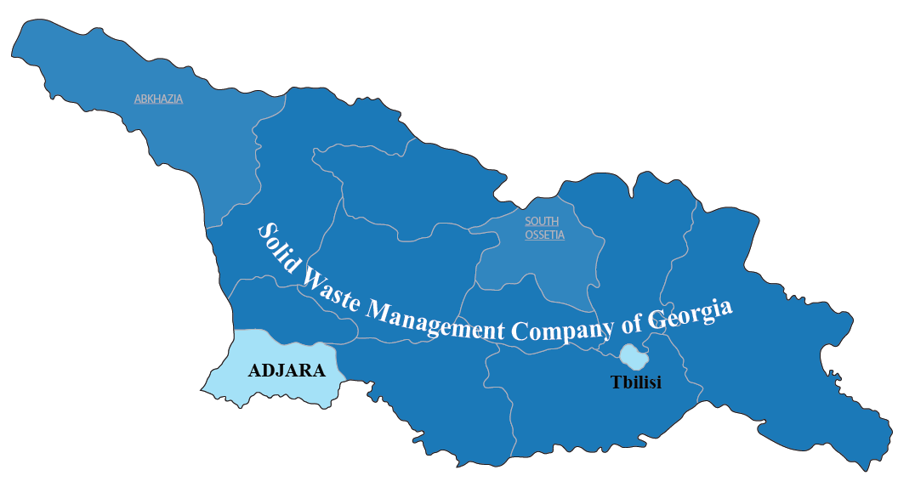
2017 - three main landfill operators
Solid Waste Management Company of Georgia – 54 landfills in 9 regions
Municipality of Tbilisi – landfill close to Lilo
Autonomous Region of Adjara – landfills in Batumi and Kobuleti

Slide 4

Solid Waste Management Company of Georgia (SWMCG) in brief
Established on April 24, 2012 as private company (Ltd.) under the Ministry of Regional Development and Infrastructure, which holds 100 % shares of the company
Since 2013, the company owns and operates 54 former municipal landfills
The company has a total of 277 staff (58 in the head office Tbilisi and 219 in 9 regional offices)
The company is responsible for solid waste management with respect to landfills in Georgia, excluding the city of Tbilisi and the Adjara region

Slide 5
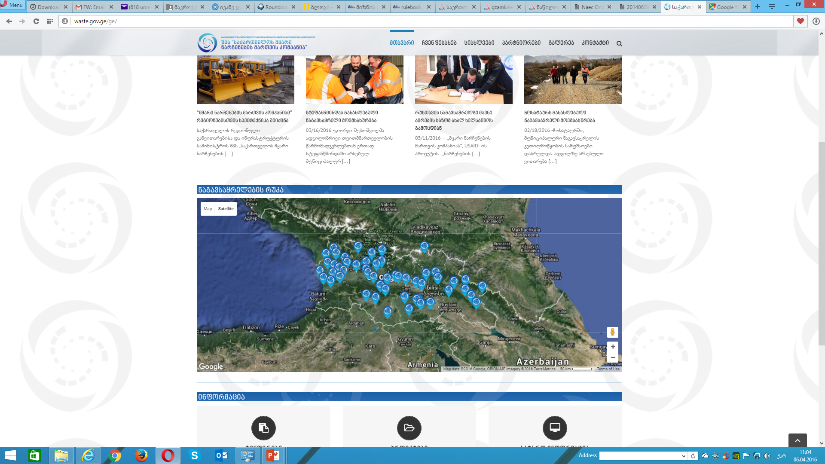
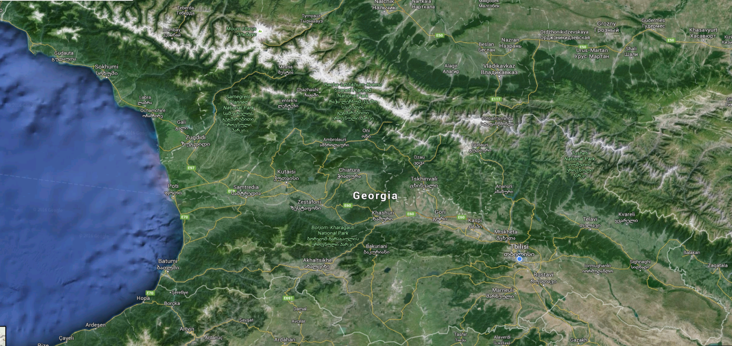

From municipal landfills to regional landfills
National Waste Management Code
National Waste Management Strategy
National Waste Management Action Plan
2025
2017
54 + 3 existing municipal landfills
8 to 9 planned regional sanitary landfills
Out of the 54 landfills, SWMCG has reconditioned and secured 30, 21 were closed and 5 transfer stations were built
At present SWMCG has running projects for building the landfills in Imereti, Kvemo Kartli, Kakheti and Samegrelo Zemo Svaneti

Slide 6



Integrated Solid Waste Management Kutaisi – Who is Who?
Construction and Operation
Technical Assistance
Financing
Grant EUR 2 mio
Constructor and Operator
Capacity Building / PR
Loan EUR 20 mio
100% owner of SWMCG
Technical planning of landfill
State budget EUR 4 mio

Slide 7
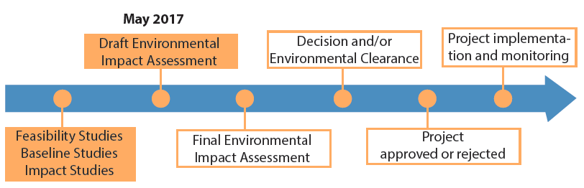
Integrated Solid Waste Management Kutaisi – Situation of the New Landfill
On 11 May 2017 the Draft Environmental Impact Assessment (EIA) was presented to the public in Terjola
The Ministry of Environment needs to approve the EIA before any further step can be taken. This process is underway.

Slide 8
Project Activities – Supporting SWMCG to assure safer working conditions - Operational Health and Safety training
13 managing staff of landfills – intense training and support
Implementation of an action plan for 2018 and of monitoring an control system
Project Activities – Municipal Waste Management Plan Training
Legal obligation according to waste management code – municipal waste management plan until end of 2017 from each municipality
7 training sessions for 16 municipalities from Imereti, Racha-Lechkhumi and Kvemo Svaneti since November 2016
Support in all relevant fields: technical, logistical, management, financial, PR

Slide 9
Project Activities – Lectures at University Kutaisi
First lecture in June 2017 – more lectures this autumn and during next year
Project Activities – more regional PR activities
More intense regional communication will be started when final decision for landfill will be made

