Slide 1
Integrated Solid Waste Management Kutaisi
– Accompanying Technical Training –
2nd Training
“Municipal Waste Management Planning“
conducted in the period Dec. 14-15, 2016
for
Municipalities & Services responsible for managing municipal waste (MSW) in the Imereti and Racha-Lechkhumi-Kmevo Svaneti region of Georgia
Accompanying Measures Consultants of

Slide 2
Integrated Solid Waste Management Kutaisi
– Accompanying Technical Training –
2nd Training
“Municipal Waste Management Planning“
Flashback: Elements of WM plan - Status part -
provided by Jan Reichenbach, International Expert for Solid Waste Management

Slide 3
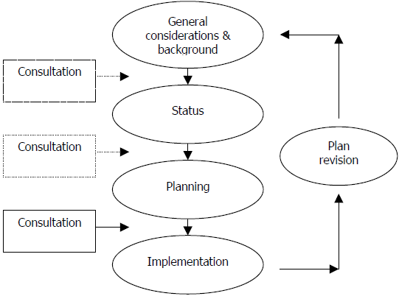
MSW planning process
Our focus in:
December training
February training

Slide 4
WM plan elaboration
Principal sections of WM plan
Scope, Objectives, Background, Duration, Conditions, Limitations, Priorities/Visions
→ Starting Conditions (Status Part) e.g. quantities, quality, collection, equipment, recycling/disposal, actual(!) costs, cost recovery/access to funds, administrative/human capacities/technical qualifications (WC art. 13(4) a-d, g, h if relevant )
→ Planning part
planned measures, activities, investments + ways and time frame, responsibilities, estimated costs and financing sources (WC art. 13(4) e-i)
→ Procedure (when, how, with whom, what basis)

Slide 5
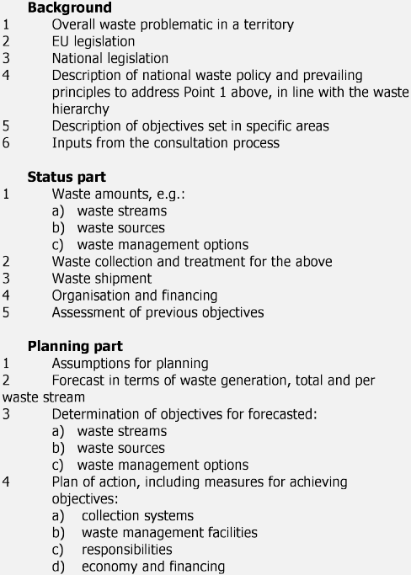
Georgian WMP requirements and EC WMP guidance note

Slide 6
Further regulatory provisions
here: TECHNICAL REGULATION On MUNICIPAL WASTE COLLECTION AND TREATMENT RULE (Municipal Waste Collection By-Law)
Article 9. Planning and Implementation of the collection system
1. When planning and implementing an efficient municipal waste collection system, a municipality and other providers of waste collection service need to consider:
a) Characteristics of waste to be collected and waste collection system coverage zone;
b) Selection of a municipal waste collection technique that is efficient and compatible with local geographical and socio-economic conditions of the municipality where service is provided;
c) Peculiarities of a landscape of a city, village or borough within the service that may to a certain extent affect municipal waste collection methods within various areas of a municipality.

Slide 7
Further regulatory provisions
here: TECHNICAL REGULATION On MUNICIPAL WASTE COLLECTION AND TREATMENT RULE (Municipal Waste Collection By-Law)
Article 9. Planning and Implementation of the collection system
2. A municipality shall ensure:
a) Efficient municipal waste collection service provision within the municipality’s borders taking into account its financial resources;
b) Improvement and expansion of a municipality’s existing collection system based on consideration of the experience.
c) Introduction of an efficient waste collection based on modern cost-benefit practice of service implementation;
d) Using equipment ensuring economical, quality and stable service;
e) Cooperation with population and organizations to participate in separation system;
f) Obtaining sufficient information on operation and maintenance of existing system;
g) Collection of appropriate information related to municipal waste collection;
h) Periodic investments in replacement equipment;
i) Ensuring sustainable technical and management capacities.

Slide 8
WM plan - Making of: Specifying general framework
Objectives:
[1st training]: What do you want to achieve with a WM plan?
Ensure proper waste collection and disposal;
Ensure payment, ensure payment taking social aspects into consideration;
Ensure clean city, for people and for tourist;
Support employment;
Contribute to climate measures;
Provide legal basis for association options
☞ See slides on ‘Objectives in WM plan(ning)’ [2nd training]

Slide 9
Relevant legislation
Conditions
Area covered and conditions - Location, size, elevation, climate
Population - Number, age classes, social status/employment - also population dynamics/migration, seasonal changes (tourism)
Structures - dwelling/building structures, number/size of villages - relevant infrastructures (road/railroad connections) - local industries
Division of SWM responsibilities
Limitations applying

Slide 10
WM plan - Making of: Specifying starting conditions (Status part)
Quantities and quality
Where generated (Sources of waste generation)
How much generated – How much collected (Not all what is generated is collected!) - Generation largely depends on source, individuals, season, social status - Collection largely depends on behavior, equipment, service
What is collected (waste types, material content)
How is collected quality - applies in the case of targeted (source separated) material streams
How does quality vary (seasonal change)

Slide 11
Collection
What services are offered - how can citizens dispose of waste - for which materials
What coverage is achieved (places/population connected/not connected to these services)
Collection settings (Number/capacities/arrangement of containers)
Collection frequency (How often is collected)
Separate collection (How, when, public awareness)

Slide 12
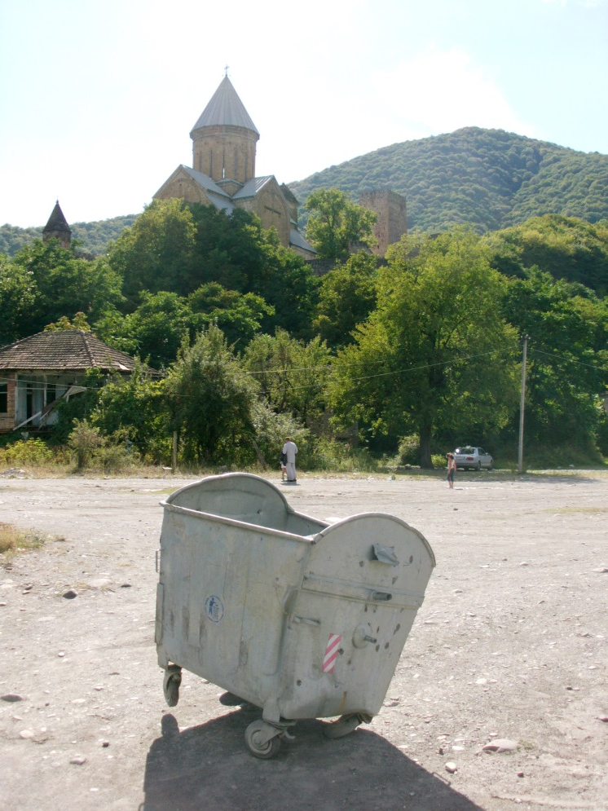
Equipment
What devices are available / are used - for collection (e.g. containers) - for pickup (e.g. lifter trucks) - for transportation (e.g. trucks) - for handling (e.g. bulldozer, crane, press)
How many of them
Where located/by whom used
How is state of equipment (what is planned usage period/when does it go out of operation)
What is the usable capacity

Slide 13
Public awareness and public cooperation
How do you intent to inform and work with neighboring municipalities?
How do you intent to inform and work with the MoENRP, SWMCG and other state institutions?
How to involve the public?
Via discussions about this plan
Via information campaigns/leaflets/radio and TV

Slide 14
Costs/financing
What are the waste management-related cost positions - collection - transportation - disposal - personnel / administration
Relations with any other duties (e.g. water/sewage services, cemeteries)
Employed cost recovery mechanisms - fees charged - fee enforcement, defaults in payment
Other sources/funds for financing

