Slide 1
Integrated Solid Waste Management Kutaisi
– Accompanying Technical Training –
3rd Training
“Municipal Waste Management Planning“
Where we want to be (Preparations and homework till February training)
Achievements overview
provided by partcipating Municipalities

Slide 2
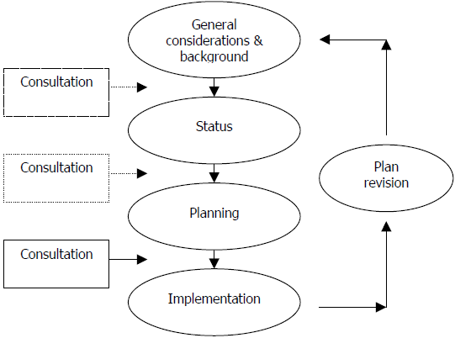
MSW planning process
Our focus in:
December training
February training

Slide 3
Homework
Find an example/reference WM plan to become your orientation - which one/what you like to adopt you should present in February!
Start creating the format for your WM plan - do the outline / list of content - do formulate visions/objectives (draft!) - name limitations and challenges - create chapter on the legal references/framework (only the relevant documents, only the relevant stipulations/deadlines, highlighting priorities addressed by your WM plan no copy & paste of the entire documents / legislative text !!!!)
Collect information relevant for future development dynamics
Begin drafting chapters with status information - coverage, territorial data - status quo of collection, equipment, costs - forms / routes of disposal

