Slide 1
Waste management planning
WHY?
René Boesten

Slide 2
4 topics:
What is this project about?
What is the benefit of a WM plan?
Cooperate!
Our role

Slide 3
What is this project about?
The Solid Waste Management Company of Georgia is rehabilitating and closing existing landfills and opening regional landfills
Technical assistance for the investment and for capacity building
Capacity building for the SWMCG and for municipalities (in waste management planning)
Develop cost recovery mechanisms (gatefee and waste service fee)

Slide 4
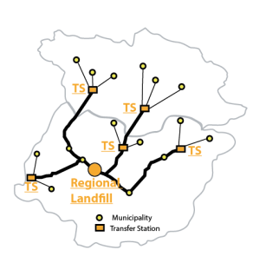
What is this project about?
Imereti and Racha-Lechkhumi/Kvemo Svaneti

Slide 5
What is a WM plan?
Waste Code, article 13 (4): The Municipal Waste Management Plan shall contain the following:
information on the existing system for collection of waste from population;
data on the types and the amounts of non-hazardous waste collected, recovered and disposed of;
data on the types and the amounts of hazardous waste from population collected, recovered and disposed of;
location of the waste treatment facilities;
planned measures to be taken for the establishment of separate collection and recovery of municipal waste, including of biodegradable waste and packaging waste;
planned construction of new waste treatment facilities;
programmes to raise awareness of the public on waste management issues;
implemented and planned measures for co-operation with other municipalities in the field of waste management;
the way and timeframe in which the proposed measures shall be implemented, responsible persons, estimated costs and sources of financing for their implementation.

Slide 6
Objectives and purpose
Integrated part of municipal development
Complexity and benefits
Inform, invite and involve stakeholders
Manage long term solutions
Justify costs and investment
Manage problems
Compliance

Slide 7
Objectives and purpose
Integrated part of municipal development
Waste service fee explained and justified;
Waste service fee balanced with socio-economic aspects;
Waste collection and transport defined and future needs justified;
Communication with citizens established;
Make links between clean city and tourism;
Make links between employment and clean city;

Slide 8
Cooperate!
Municipal waste associations:
Share equipment
Share experiences and knowledge
Share human resources
Note: art 13 (3) The adoption of the Municipal Waste Management Plan shall be preceded by public consultations, involving the relevant stakeholders and the neighbouring municipalities. These public consultations shall be carried out by the respective municipality(ies).
Cost effective use of equipment
Cost effective use of human resources
Economy of scale for separate collection

Slide 9
Our role
Assist in the analysis of the present situation
Assist in finding solutions
Assist in preparing procurement plan(s)
Assist in public awareness
Assist in cost assessments
Assist means: “work with you”,
not “work for you”

Slide 10
თუ გული გულობს, ქადა ორი ხელითაც იჭმევა
(where there is a will, there is a way)

