Slide 1
Integrated Solid Waste Management Kutaisi
– Accompanying Technical Training –
Introductory Training
“Municipal Waste Management Planning“
General training concept and schedule Your assisting team
provided by Jan Reichenbach, International Solid Waste Management Expert, INTECUS GmbH

Slide 2
Framework settings (I)
2017 deadline of Waste Code for submission of municip. waste mgt. plans
➔ leaves only about 1 year of time!
Requirement for WMPs to have a coverage of five years Note: - ‘treatment‘ obligation for waste to be disposed of on new landfills - 2019 deadline for introduction of separate recyclables collection
➔ agreed concepts must already be part of the 1st municipal waste mgt. plan!
Obligation for annual waste reporting of Georgian municipalities i.e - waste must be monitored by them - locally won data are the most reliable and meaningful ones
➔ new skills are definitely needed and must be continuously enhanced!
The project ‘ISWM Kutaisi’ i.e - region will benefit from a new SWM infrastructure incl. a central landfill - possibility to pilot extended services and separate collection
➔ a good basis for municipal waste mgt. planning already exists, use it!

Slide 3
Framework settings (II)
Target participants:
Municipalities in the project area
Special points of concern/attention:
Distances to the future central landfill
Local conditions which increase challenges to effectively manage and transport wastes - Ambrolauri – rural, Tqibuli – suburban type, Kutaisi – urban type
Different capacities and experiences - Ambrolauri, Tqibuli – with no WMP experience yet - Kutaisi – already pioneered in WMP, has perhaps new visions and ideas but faces new challenges as well
Capacity limits also of the AMC team (not the team’s but the municipalities’ activities -including efforts to associate/co-operate with each other- are the key to success)

Slide 4
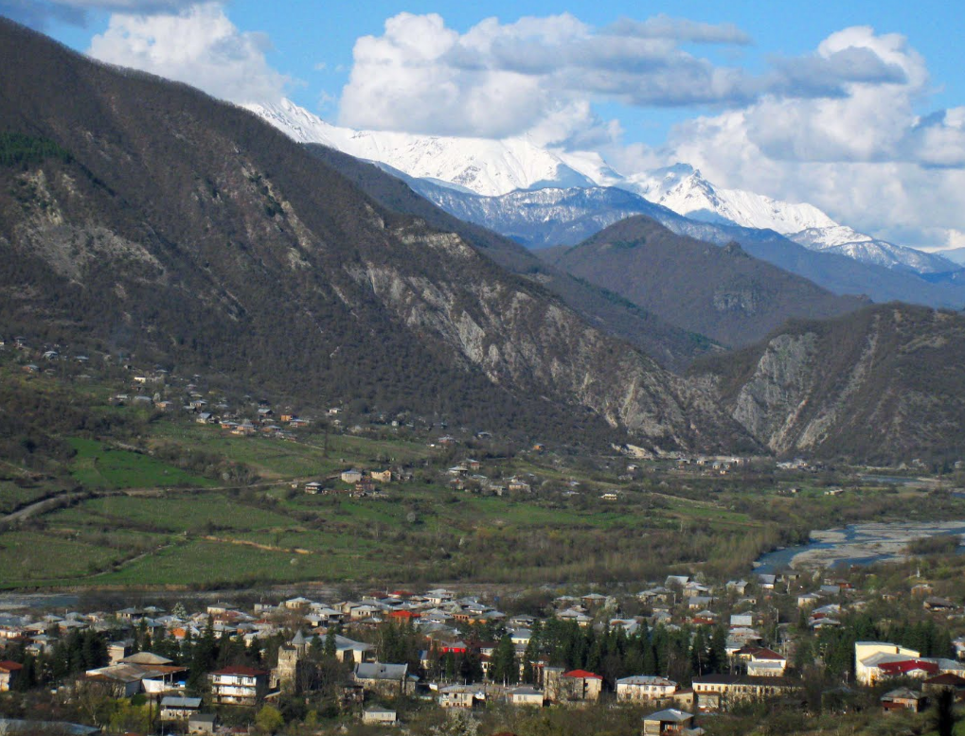
The „mountainous“ (project) municipalities (here: Ambrolauri)
≈3,000 inh.
Waste collection in town + 14 settlements,
2 trucks 12 cbm in total,
90 bins 1.1 cbm, 1 controlled landfill

Slide 5
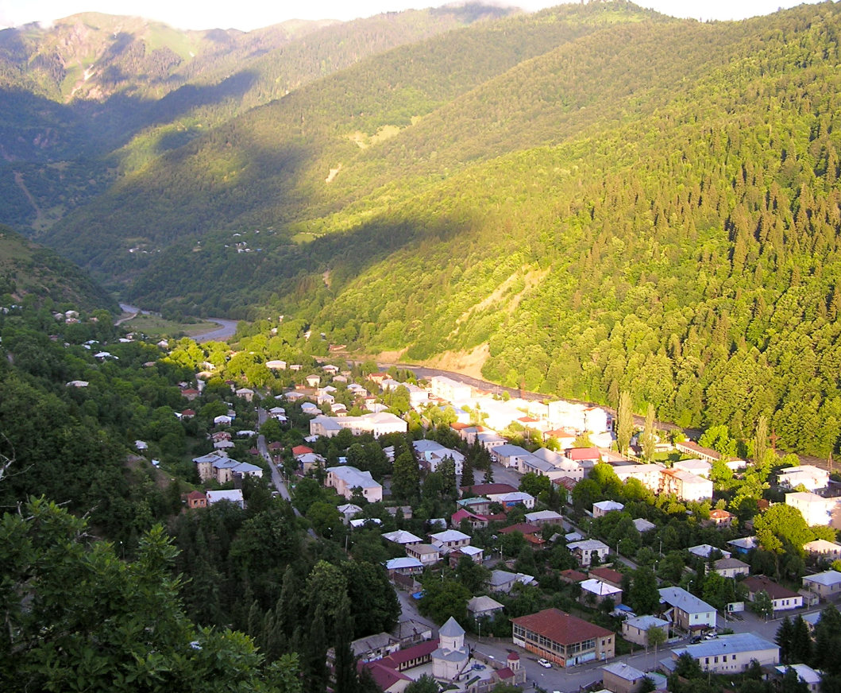
The „mountainous“ (project) municipalities (here: Lentekhi)
≈2,000 inh.
Waste collection ocassionally with 1 open truck,
almost no bins, waste dumped rather wildly outside of town

Slide 6
Training objectives
Municipalities that attended the training should:
be aware and knowledgeable on the WMP requirement and needs
enabled to use appropriate methods and employ a wider toolbox for WMP
have developed a WMP (“at least in the core parts by themselves, ideally up to the point of political approval”) to comply with 2017 deadline
have established municipal and stakeholder interactions (SWMCG, public) all which includes that reasoned decisions were made for that

Slide 7
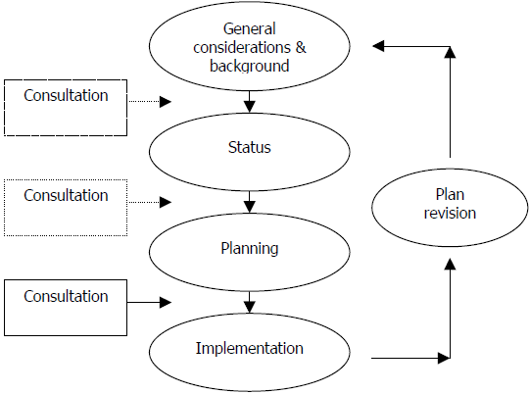
WMP training general concept (I)
The planning process
Phased approach:
3 phases - sensitization
- mobilization
- enabeling
+ follow up (= piloting + experience sharing)
2017
2017
2017
2018 -
is making up a chapter in the WMP BUT
is also the process of repeatedly updating the plan hence something municipalities must do (at the latest after 5 five years and then be capable for without the support of the AMC team)

Slide 8
WMP training general concept (II)
Participative approach:
The process of drafting the plan is equally important as the plan itself
It creates ownership;
It ensures connections with the day to day realities;
It builds knowledge and experience;
It builds political support and motivation;
Proposed means:
Any locally necessary activities (e.g. work group meetings, public hearings)
Consultative meetings; → Local consultants (Experts)
Training sessions (Lecture seminars), Workshops; → Experts
Scheduled electronic correspondence and checklists (Homework)

Slide 9
WMP training schedule (I)
Sensitization (starting Oct. 2016)
Invitation process (October)
Initiation (2nd half of November 2016)
Invitees | Action | Subjects and providers
16 municipalities of project region Political representatives Venue: Kutaisi area | Workshop | Policy and legal background (MoENRP) Planning rationale/needs (MoENRP, AMC) SWM planning experience (Municip.) Existing guidance tools (CENN) Training concept (AMC) Discussion
 | Lecture seminar | WMP principles & procedure Requirements Best Practice examples/Inter-municip. association WMP components Get started

Slide 10
WMP training schedule (II)
Mobilization (starting December 2016, up until April 2017)
Invitees | Action | Subjects and providers
Municipalities (who indicated a sufficient interest and potential to participate) Venue: Depending on number and location of attending municipalities | Coordinated consultative meetings (local counterpart w. trainers super-vision) | Advisory assistance in specific issues (AMC)
 | Lecture seminar (w. foreign trainers) | Approach to WMP status part Stakeholder interaction/ Intermunicipal cooperation Discussion on objectives and visions, application of tools Next steps

Slide 11
WMP training schedule (III)
Enabeling (depending on progress, perhaps starting April 2017)
Invitees | Action | Subjects and providers
Municipalities that have been active and collaborative throughout the process from the beginning and the potential to lead/complete WMP in due time Venue: Depending on number and location of attending municipalities | Coordinated consultative meetings | Advisory assistance in specific issues and application of tools Attended WMP development
 | Lecture seminars/ workshops | As required for introduction of certain tools, discussion of general problems and problem resolution (AMC, different sector experts)
Follow up (depending on progress, unlikely to start before autumn 2017)
Invitees | Action | Subjects and providers
16 municipalities of project region Venue: One pioneer municipality | Workshop | Introduction of the developed WMP Review of the process Recommendations and tools for replication by other municipalities

Slide 12
Assisting team
AMC ISWM Kutaisi:
Waste Management issues Jörg Wagner (Waste Management Specialists) Jan Reichenbach (Waste Management Specialists) Giorgi Bedenashvili (Environmental Specialist)
Institutional/organizational aspects René Boesten (Institutional Specialist)
Financing issues Hakan Mat (Financial Specialist)
Public relation issues Ulrich Roth / Anano Asatiani (PR Specialists)
MoENRP

Slide 13
First homework
Formation of task force/working group in municipalities
Collect information/commitment re. municip. resources / schedule, stakeholder involvement, relations with other plans, visions
Further process needs
political support
allocation of staff/time
clear links to other duities
clarity and discussion basis (scope, time horizon, focal points/visions, identified participants...)

Slide 14
Basic references/tools
Guidelines published:
Preparing a Waste Management Plan, a methodological guidance note, 2012, published by the European Commission, DG Environment; etc. see also guidelines of WB, UNEP and UNDP
Municipal Waste Management Plan Development Guideline, January 30, 2015, prepared by ICMA and CENN;
Note: deadline of MoENRP for guidance approval by Dec. 2016
Georgian examples:
Waste management action plan Kutaisi, 2015
Recognized tools:
E.g. waste prognostic methods, cost prognosis tools

