Slide 1
Integrated Solid Waste Management Kutaisi
– Accompanying Technical Training –
Introductory Training
“Municipal Waste Management Planning“
Basics of WMP planning and relation to ISWM concept
provided by Jan Reichenbach, International Solid Waste Management Expert, INTECUS GmbH

Slide 2
Todays (environmental) challenges
…underline the need for an integrated waste management
growing population / consumption
rising energy demand
growing waste amounts
growing emissions
land and material shortage
depletion of the natural resources
pollution of the environment
climate change
Economic / cost implications
Social (fairness) implications
Political implications (risk of crisis, tensions, wars)

Slide 3
დღევანდელი (გარემოსდაცვითი) გამოწვევები
…ხაზს უსვამენ ნარჩენების ინტეგრირებული მართვის აუცილებლობაზე
ზრდადი მოსახლეობა / მოხმარება
ზრდადი მოთხოვნილება ენერგიაზე
ზრდადი ნარჩენების რაოდენობა
ზრდადი ემისიები
მიწისა და მასალების ნაკლებობა
ბუნებრივი რესურსების ამოწურვა
გარემოს დაბინძურება
კლიმატის ცვლილება
ეკონომიკური შედეგები / ხარჯები
სოციალური (სამართლიანობის) შედეგები
პოლიტიკური შედეგები (კრიზისების, დაძაბულობის ომის რისკები)

Slide 4
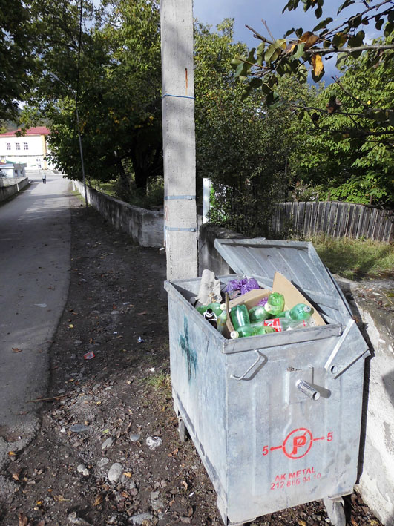
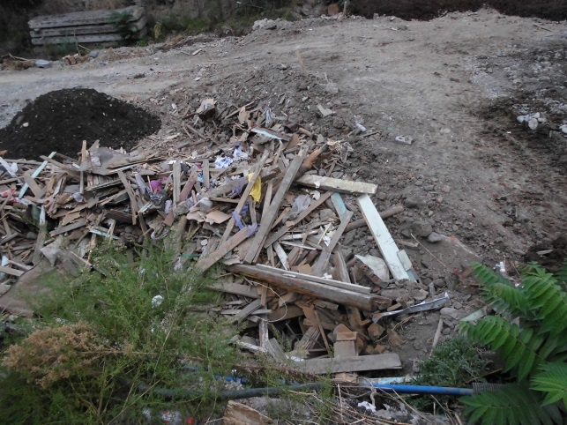
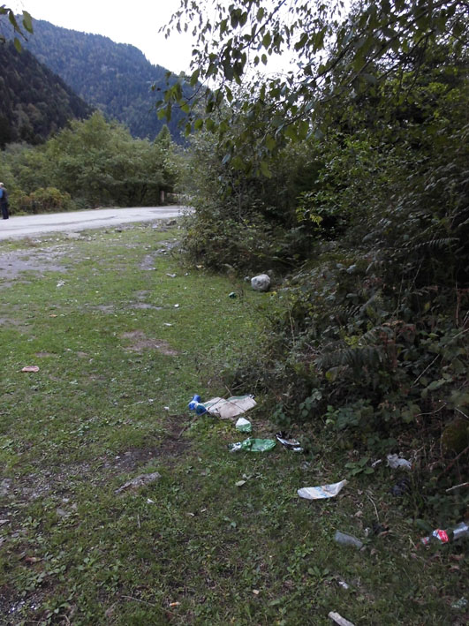
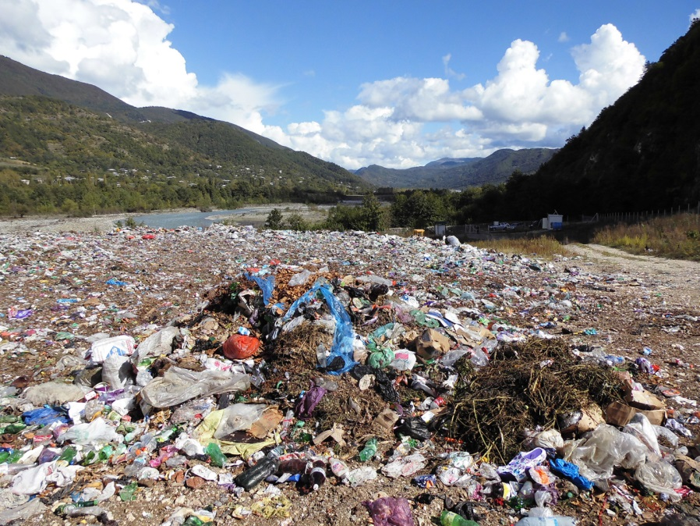
Todays (environmental) challenges
…can be seen in the region too
land shortage
depletion of resources
growing waste amounts
pollution of the environment

Slide 5
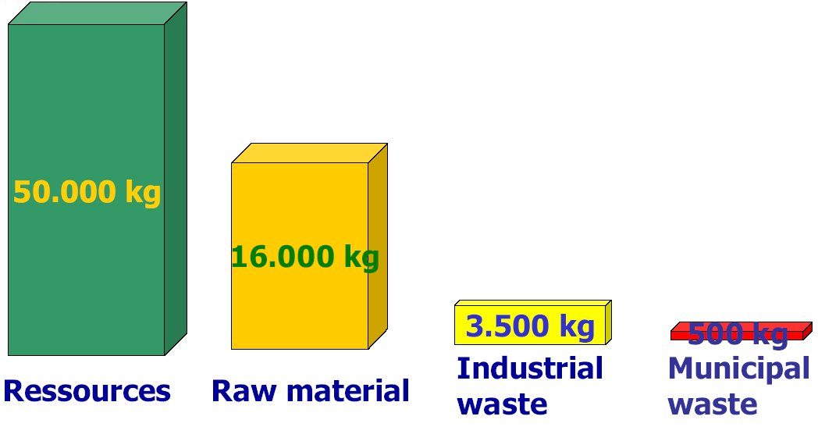
The ‘economics‘ of waste
Annual material footprint of one EU-citizen
graphic provided by ACR+
Need of shifting from a waste to a resource management !!

Slide 6
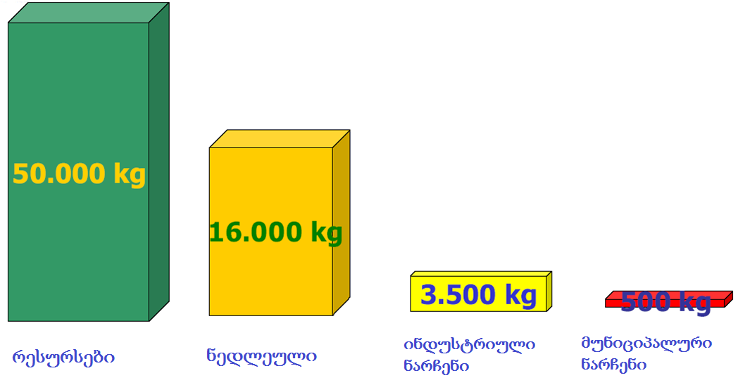
ევროპა
ერთი ევროკავშირის მოქალაქის ნარჩენების ყოველწლიური კვალი
graphic provided by ACR+
ნარჩენების მართვიდან რესურსების მართვაზე გადასვლის აუცილებლობა !!

Slide 7
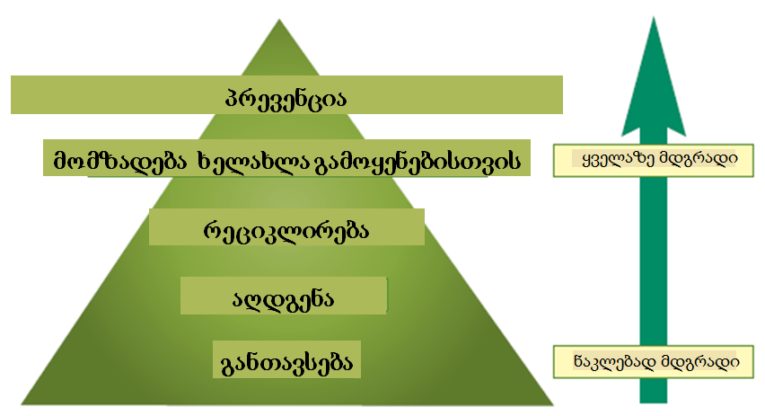
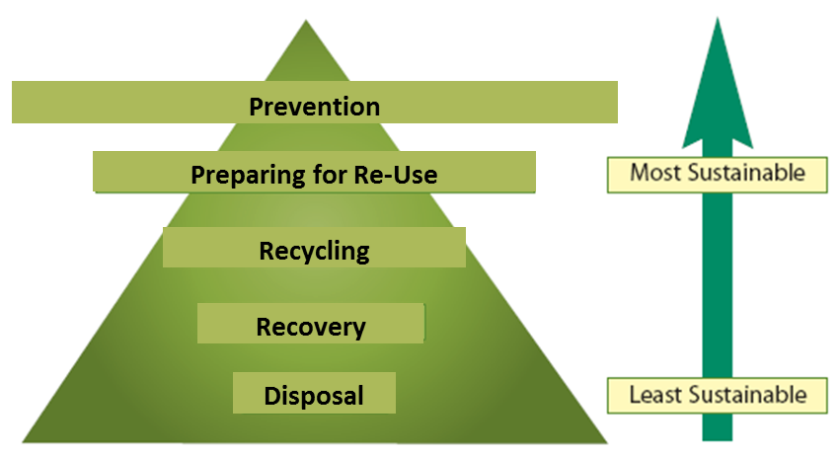
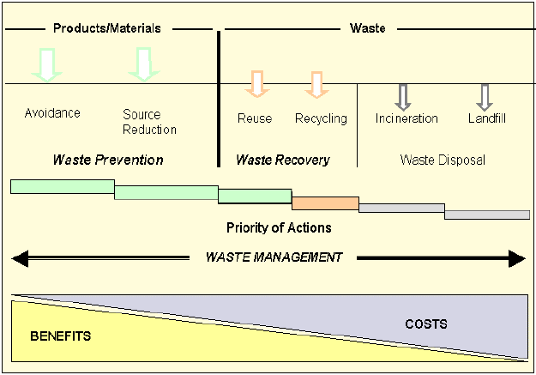
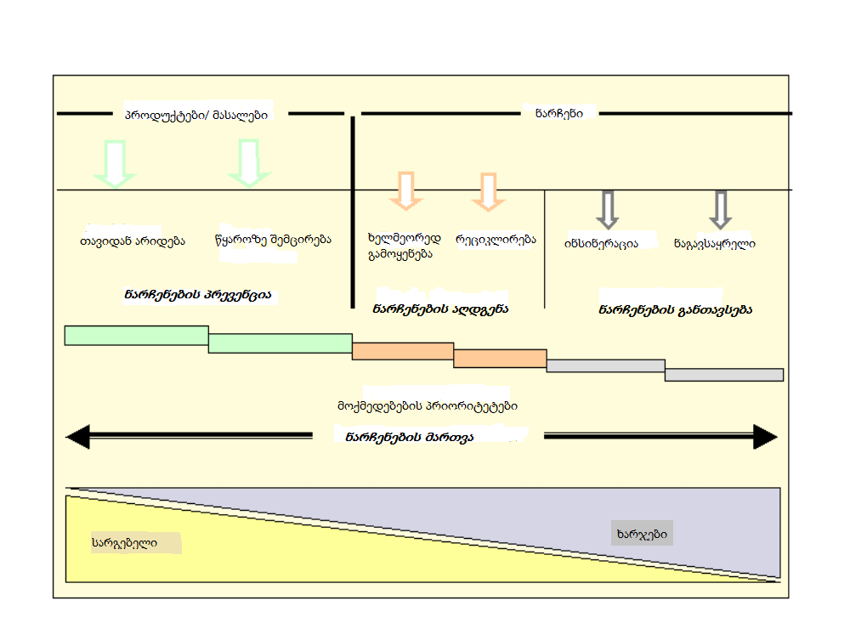
Implementing the “Waste Hierarchy“
graphic adapted from EC materials
Graphic adapted from Stutz 1999 in OECD, 2000, p. 38

Slide 8
Objectives of integrated waste management
The major concerns are
1. to ensure that no harm goes out from waste to any organism and the nature,
2. to save materials and secure future generations access to the necessary resources,
to save the climate and minimize greenhouse gas (GHG) emissions created by waste.
ISWM in addition has strong links with:
new industries and markets,
job generation and
chances for social integration and stability.
graphic www.pce.govt.nz

Slide 9
Consequences of shifting towards ISWM
New challenges and planning needs
BEFORE: One single waste stream for disposal
NEW: Complex scenarios for various material streams and their management
→ different collection requirements
→ increasing uncertainties/risks, e.g. quantities, quality, markets
→ higher administration
→ more stakeholders to deal with
→ different legal implications
→ multiple qualifications
→ multiple monetary flows

Slide 10
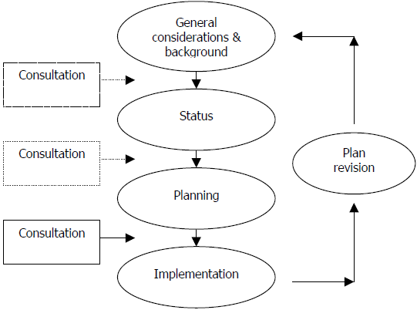
Waste management planning process
The process flow
is making up a chapter in the WMP BUT
is also the process of repeatedly updating the plan hence something municipalities must do (at the latest after 5 five years and then be capable for without the support of the AMC team)

Slide 11
Important aspects in WMP planning (I)
WM planning is laborious and time consuming ETC experience is for the process to normally take about 18 months!
Political decisions normally mark / stand at the beginning - the national SWM strategy and legal stipulations - the local objectives and visions
Local leaders/municipal administrations therefore must make up their mind on

Slide 12
Important aspects in WMP planning (II)
Example: Relationships with other planning
WM planning is not a stand-alone measure, decoupled from other municipal activities and planning work!
There are different, stronger and weaker relationsships, inter alia with
Spatial planning
Infrastructure planning
Environmental planning
Economic planning
Energy planning
Emergency planning
Health/safety planning

Slide 13
Important aspects in WMP planning (III)
Other questions/issues to be discussed/decided:
what coverage shall the plan have - territorial - types of waste - sector-wise - time-wise
what are the objectives/visions for the specific area - „green“ image - cost efficiency - self-sufficiency
partners

Slide 14
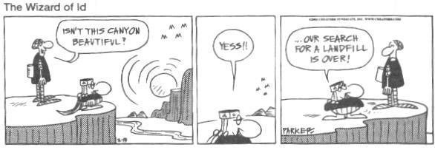
Important aspects in WMP planning (IV)
Example: Whom to involve in the process
Political and administrative representatives
Waste management actors (collectors, recyclers, facility operators)
Industry/industrial and commercial (tourism!) organisations
Sector associations/councils
NGOs
Sector experts (waste, logistics, finance, health)
others
Let‘s not forget: The right for public information and participation in decision-making (Aarhus Convention and waste code)

Slide 15
Some elementary planning principles
Realism - don‘t be too overambitious
Prudence - don‘t plan without to analyse and understand first
Accuracy - plan with care but don‘t go beyond the necessary level of precision
Transparency - don‘t be ignorant of public concern and opinion
Economic sense - always be aware of the costs (eventually everybody has to pay for it)

Slide 16
References/tools available
Guidelines published:
Preparing a Waste Management Plan, a methodological guidance note, 2012, published by the European Commission, DG Environment; etc. see also guidelines of WB, UNEP and UNDP
Municipal Waste Management Plan Development Guideline, January 30, 2015, prepared by ICMA and CENN;
Note: deadline of MoENRP for guidance approval by Dec. 2016
Georgian examples:
Waste management action plan Kutaisi, 2015
Recognized tools:
E.g. waste prognostic methods, cost prognosis tools

Slide 17
