Slide 1
Visiting PR departments of all 17 municipalities – findings and conclusions
PR and Communication
June 2017

Slide 2
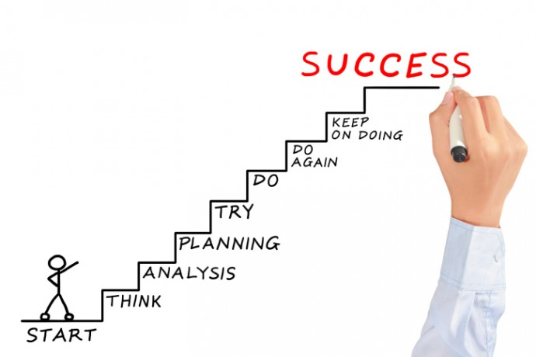
Formula of success

Slide 3
Visiting PR departments of all 17 municipalities February - March 2017
The main scopes of visit:
To inform about the overall Integrated Solid Waste Management Kutaisi Project and the roles of all involved partners and stakeholders → Many PR departments were not informed sufficiently about the project
To inform about the ongoing series of trainings on Municipal Waste Management Plans and the need to integrate the topic "PR and public awareness" into the Municipal Waste Management Plans → Many PR departments were not yet informed by the other departments about and involved in elaborating the plans
To understand the local situation and get an idea of past and present municipal PR activities, available staff, resources and budget and the existing channels and means of communication locally available → We could get very good information about the real situation ‘on the ground’
To get in direct personal contact with the PR staff of the municipalities → ☺ We know now with whom we will work in future

Slide 4
Overall findings:
The importance given to PR work by the municipality reflects in staffing. Many PR departments are understaffed
In most cases the PR departments have no dedicated budget
No municipality has a PR and communication strategy and / or annual communication plans formally drafted and agreed
Regular communication and information sharing trough FB closed group
of PR units of the municipalities of Imereti Region

Slide 5
Overall findings:
All municipalities have FB acounts
All municipalities have web pages (except Tskaltubo)
Most municipalities have a newspaper that is published regularly.
In several cases there exist agreements of continuous collaboration with local TV stations
Direct Communication with local population. Events are in most cases planned weekly/ ongoing ad-hoc

Slide 6
Main Channels of Communication used by Municipalities
Facebook
Is the main channel of communication in case of all 16 Municipalities
The Facebook pages are regularly updated and contain following information:
Municipality activities,
Articles shared from their web;
Photo/ video gallery
events taking place in the region
The pages also contain: info graphics, initiatives and achievements of the Government (e.g. what people should know about visa free regime; legislation initiatives by Parliament of Georgia; infrastructural and agricultural initiatives, social, education and healthcare programs and so on)

Slide 7
Main Channels of Communication used by Municipalities
Web page
All municipalities have got a web page (except Tskaltubo)
The web pages are designed well and more or less have the same structure and style, but in some cases some section does not contain any information:
Short news
Photo/video gallery (in some cases only touristic/sightseeing photos )
Announcements (e.g. Competitions; social programs; health programs and projects implemented by NGOs)
Hot line number
Contact persons and contact numbers of all administrative unit representatives
Sakrebulo meeting minutes, bylaws, resolutions, annual budget and annual reports

Slide 8
Main Channels of Communication used by Municipalities
Newspaper
Most municipalities have a newspaper that is published regularly. The frequency ranges from weekly to monthly, the number of pages reach from 4 to 12 pages. These publications are produced by so called "N (N) LE ", non-commercial, non-profit legal entities financed by the municipal (Gamgeoba) budget. Newspapers are distributed by the municipality mostly free of charge
Local TV stations
In several cases exist local TV stations and municipalities usually make annual contracts with these TV stations

Slide 9
Main Channels of Communication used by Municipalities
Events
Regular clean-up activities involving schools
Public meetings of Gamgebeli
Opening of renovated schools; kinder gardens etc.
Culture events (celebration of anniversaries; various public events)
Sport events and competitions for school children
Direct communication with local population/"word of mouth"
Direct communication with citizens during events, through local groups or on a community ("Temi") level. This way about 20% of the population would be reached directly as it was estimated by the PR department of Samtredia)

Slide 10
Overview of finding of existing challenges in PR work:
No dedicated budget for PR activities
Lack of employees in many cases
Lack of internal communication through the departments and information sharing experience
Low understanding of PR and public relations importance on a top management level
Ongoing ad-hoc planning
Low awareness of PR employees of functions, obligations and tasks related to waste management issues
Lack of public awareness activities/ publications and print material
Low awareness of waste management issues and it’s importance through public

Slide 11
Some ‘highlights’:
Municipality of Kharagauli PR activities:
Production of a series called "One day in the village“- Broadcasted on local TV station ‘Rioni’; uploaded on the web and FB pages
Sachkhere Municipality
Intense work on unregulated landfills (40 clean up events during 2016)
Printing antilittering stickers which has been distributed through public.
Ambrolauri
Free WiFi all over the city of Ambrolauri ☺ (is it already available now?)

Slide 12
Overall positive findings in all 16 municipality PR units
regular clean-up activities
Understanding of importance of waste management issue
Truly motivated teams driven to work hard for success

