Slide 1
Integrated Solid Waste Management Kutaisi
– Accompanying Technical Training –
Training on
“Municipal Waste Management Planning“
Continuation of the WMP process
How to structure the WM plan
(Content and compilation of a Municipal WM plan)
provided by Jan Reichenbach, International Solid Waste Management Expert, INTECUS GmbH

Slide 2
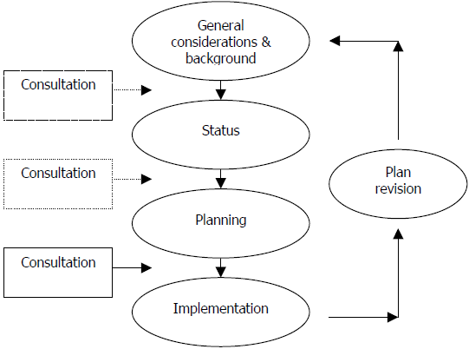
WM plan elaboration
Principal sections of WM plan
The process
Scope, Objectives, Background, Duration, Conditions, Limitations, Priorities/Visions
→ Starting Conditions (Status Part) e.g. quantities, quality, collection, equipment, recycling/disposal, actual(!) costs, cost recovery/access to funds, administrative/human capacities/technical qualifications (WC art. 13(4) a-d, g, h if relevant )

Slide 3
What is a WM plan?
Waste Code, article 13 (3):
Each municipality shall adopt a 5-year plan for the management of municipal waste generated within its territory. A municipal waste management plan may be prepared jointly by neighbouring municipalities. → Introductory chapter: Purpose and Scope
A municipal waste management plan shall comply with the national waste management action plan and plans for the management of certain types of waste under Article 12(7) of this Code. → Chapter: Legislative background
Prior to the adoption of a municipal waste management plan, public discussion involving interested parties and representatives of neighbouring municipalities shall be held. Public discussion shall be carried out by the respective municipality (municipalities).

Slide 4
What is a WM plan?
Waste Code, article 13 (4): The Municipal Waste Management Plan shall contain the following:
information on the existing system for collection of waste from population;
data on the types and the amounts of non-hazardous waste collected, recovered and disposed of;
data on the types and the amounts of hazardous waste from population collected, recovered and disposed of;
location of the waste treatment facilities;
planned measures to be taken for the establishment of separate collection and recovery of municipal waste, including of biodegradable waste and packaging waste;
planned construction of new waste treatment facilities;
programmes to raise awareness of the public on waste management issues;
implemented and planned measures for co-operation with other municipalities in the field of waste management;
the way and timeframe in which the proposed measures shall be implemented, responsible persons, estimated costs and sources of financing for their implementation. → other principal content of WM plan

Slide 5
WM plan - Making of: Specifying general framework
Objectives:
[1st training]: What do you want to achieve with a WM plan?
Ensure proper waste collection and disposal;
Ensure payment, ensure payment taking social aspects into consideration;
Ensure clean city, for people and for tourist;
Support employment;
Contribute to climate measures;
Provide legal basis for association options
☞ See additional slides on ‘Objectives in WM plan(ning)’
Relevant legislation

Slide 6
WM plan - Making of: Specifying starting conditions (Status part)
Conditions
Area covered and conditions - Location, size, elevation, climate
Population - Number, age classes, social status/employment - also population dynamics/migration, seasonal changes (tourism)
Structures - dwelling/building structures, number/size of villages - relevant infrastructures (road/railroad connections) - local industries
Division of SWM responsibilities
incl. relevant limitations applying

Slide 7
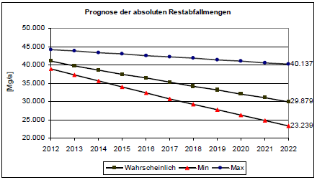
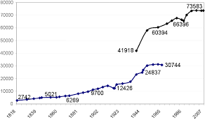
WM plan - Making of: Analysis (in status part and for planning part)
Conditions
Example: Population - Number, age classes, social status/employment - also population dynamics/migration, seasonal changes (tourism)
analyze and show historical evolution
→
it‘s needed for planning (basis for prognosis) !!!

Slide 8
WM plan - Making of: Status part
Quantities and quality
Where generated (Sources of waste generation)
How much generated – How much collected (Not all what is generated is collected!) - Generation largely depends on source, individuals, season, social status - Collection largely depends on behavior, equipment, service
What is collected (waste types, material content)
How is collected quality - applies in the case of targeted (source separated) material streams
How does quality vary (seasonal change)

Slide 9
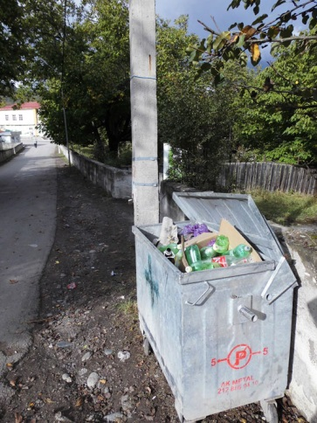
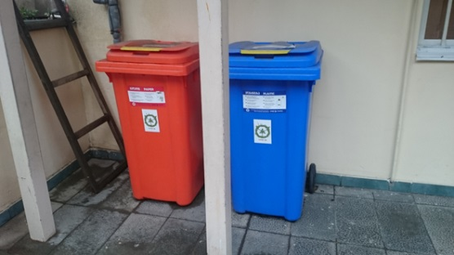
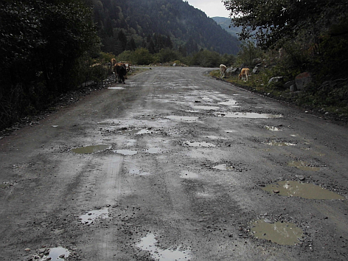
Collection
What services are offered - how can citizens dispose of waste - for which materials
What coverage is achieved - places/population connected/not connected to these services - limitations applying, e.g. bad or missing roads
Collection settings (Number/capacities/arrangement of containers)
Collection frequency (How often is collected)
Separate collection (How, when, public awareness)

Slide 10
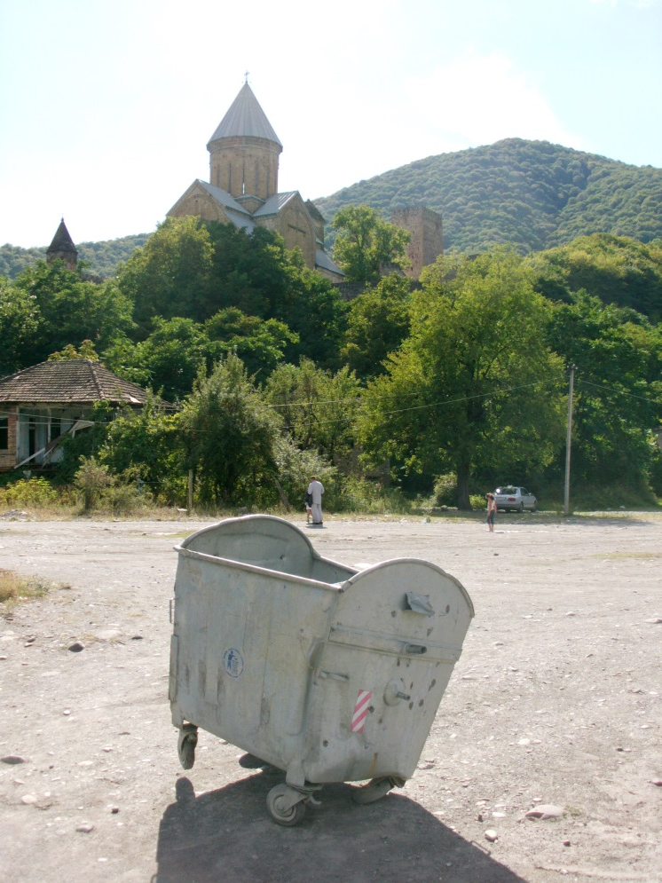
Equipment
What devices are available / are used - for collection (e.g. containers) - for pickup (e.g. lifter trucks) - for transportation (e.g. trucks) - for handling (e.g. bulldozer, crane, press)
How many of them
Where located/by whom used
How is state of equipment (what is planned usage period/when does it go out of operation)
What is the usable capacity

Slide 11
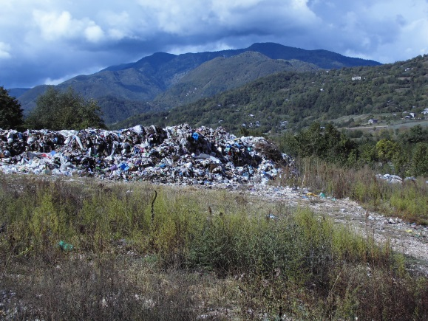
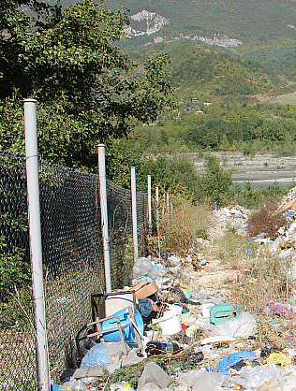
Waste treatment facilities
Type and location (e.g. open dump)
State - accessibility (how, who) - security/protection means (e.g. fenced) - recurrent problems (e.g. burning, flooding, drifts) - size/carrying capacity
Operation - usage intensity/amounts dumped - monitoring (e.g. weighing, guarded, any surveillance/testing) - safety/treatment measures carried out (e.g. earth cover) - (third party) activities (e.g. material picking, grazing)
Particularities e.g. in terms of future usage

Slide 12
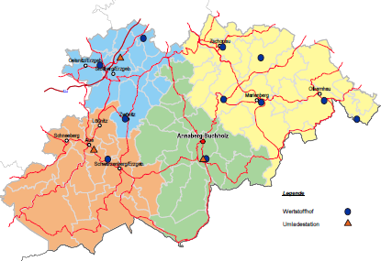
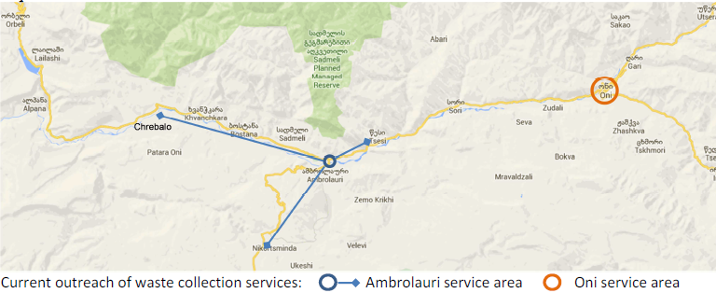
WM plan - Making of: Visualization (in status part and for planning part)
Waste treatment facilities
Example: Type, location and state
Collection infrastructure and collection coverage
work with maps (if possible)

Slide 13
Costs/financing
What are the waste management-related cost positions - collection - transportation - disposal - personnel / administration
Relations with any other duties (e.g. water/sewage services, cemeteries)
Employed cost recovery mechanisms - fees charged - fee enforcement, defaults in payment
Other sources/funds for financing

Slide 14
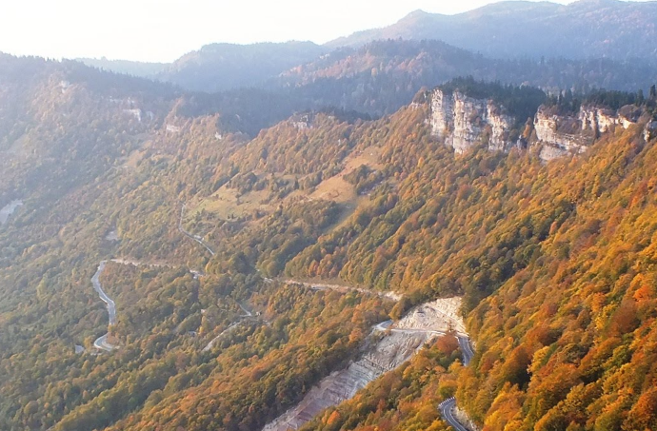
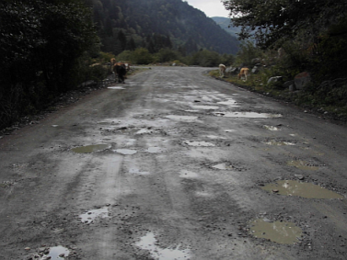
Limitations
Note: Legal passage on the recognition of (temporary) limitations applying
e.g. lack of weight bridge/equipment lack of personnel resources/qualification
Nakerala pass (1,200m a.s.l.)
Gaps / limitations emphasized so far
Topographical (incl. climatic) conditions → hampering collection efficiency, coverage, transport
Lack of weight bridges / waste records → limits knowledge on waste amounts and developments
Lack of personnel resources/qualification → limits control but calls also for optimization and to associate!
Lack of funds for equipment WMP: optimize use, collect charges, outline procurement needs
Lack of people awareness WMP: plan awareness work

Slide 15
How to deal with that in the WM plan
Regulatory provision
here: TECHNICAL REGULATION On MUNICIPAL WASTE COLLECTION AND TREATMENT RULE (Municipal Waste Collection By-Law)
Article 9. Planning and Implementation of the collection system
3. In planning and design of municipal collection and transport systems, municipalities shall define limitations that may exist in providing efficient and adequate collection and transport services. At a minimum, municipalities shall address the following issues:
a) Inadequate resource mobilization;
b) Overreliance on imported equipment;
c) Inappropriate and insufficient sources of finance;
d) Use of inappropriate technology;
e) Lack of managerial and technical capacity
f) Inequity in service provision.

Slide 16
How to deal with that in the WM plan
Some recommendations
Identify gaps/limitations (also with help of stakeholders/public)
Sort by sectors (e.g. collection-related, disposal-related...) and perceived impact / priority
Create an early chapter/section highlighting these (principal) gaps/limitations with their relevance/impacts on the WM plan
Later (in the planning part) repeat the gaps/limitations at the entrance to each specific planning part (section in the WM plan) so as to provide arguments why the plan was done as it was done and how gaps/limitations were addressed

Slide 17
How to deal with that in the WM plan
Examples from Kutaisi WM Action Plan 2015-2020
Rapid increase in waste generation, uncontrolled pollution of the environment with the waste is one of the most urgent existing problems.
2.5. Organization of municipal waste collection and removal:
Placement of containers is a serious problem
Problems related to separated waste collection:
Not enough potential for recycling of separated waste on site
Insufficiently developed waste sorting and collection methods
Non-existence of waste sorting centers or factories in Kutaisi
2.10. Hazardous waste management
Despite the fact that medical waste collection and utilization from various medical institutions is done by special companies, certain part of medical waste ends up in household waste and as a result on Kutaisi landfill, which is an exceptional problem. It has to be mentioned that the hazardous waste management system and relevant landfill do not exist in Georgia.
2.11. Inert waste management
Producers of inert waste have problems while attempting to dispose or remove it. City does not have territory for disposal of inert waste.

Slide 18
How to deal with that in the WM plan
this also goes for other subjects such as
illegal/old landfills
the animal waste (“beikers pit”) problem
.....
BUT
make sure these fall into the scope of the WM plan (“municipal waste”) and municipal responsibility
where there exists a problem or concern by the municipality refer to relevant legislation or gaps in it e.g. the upcoming by-law on animal waste management (Oct.2017)

