Slide 1
Integrated Solid Waste Management Kutaisi
– Accompanying Technical Training –
Introductory Training
“Solid Waste Management Planning“
Examples of Best Practice
provided by Jan Reichenbach, International Solid Waste Management Expert, INTECUS GmbH

Slide 2
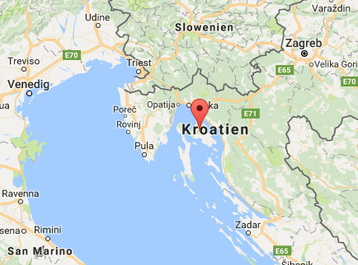
Towards an Integrated Municipal Solid Waste Management
Example case: Island of Krk, Republic of Croatia
Area: 410 square kilometres, (biggest island in the Adriatic Sea)
Population: nearly 19,000 permanent residents during tourist season, population of more than 120,000
2007: EU accession
2003: study on a new, environmentally friendly waste management system
2005: beginning of a gradual introduction of the new system
Basis of the system: - a central landfill
- separate curbside collection of five different categories
(paper, plastics and metals, glass, biowaste and remaining waste)
- recycling yards in each municipality
- a central facility to re-sort recyclables into marketable fractions and to compost the biowaste
- a system of differentiated waste fees

Slide 3
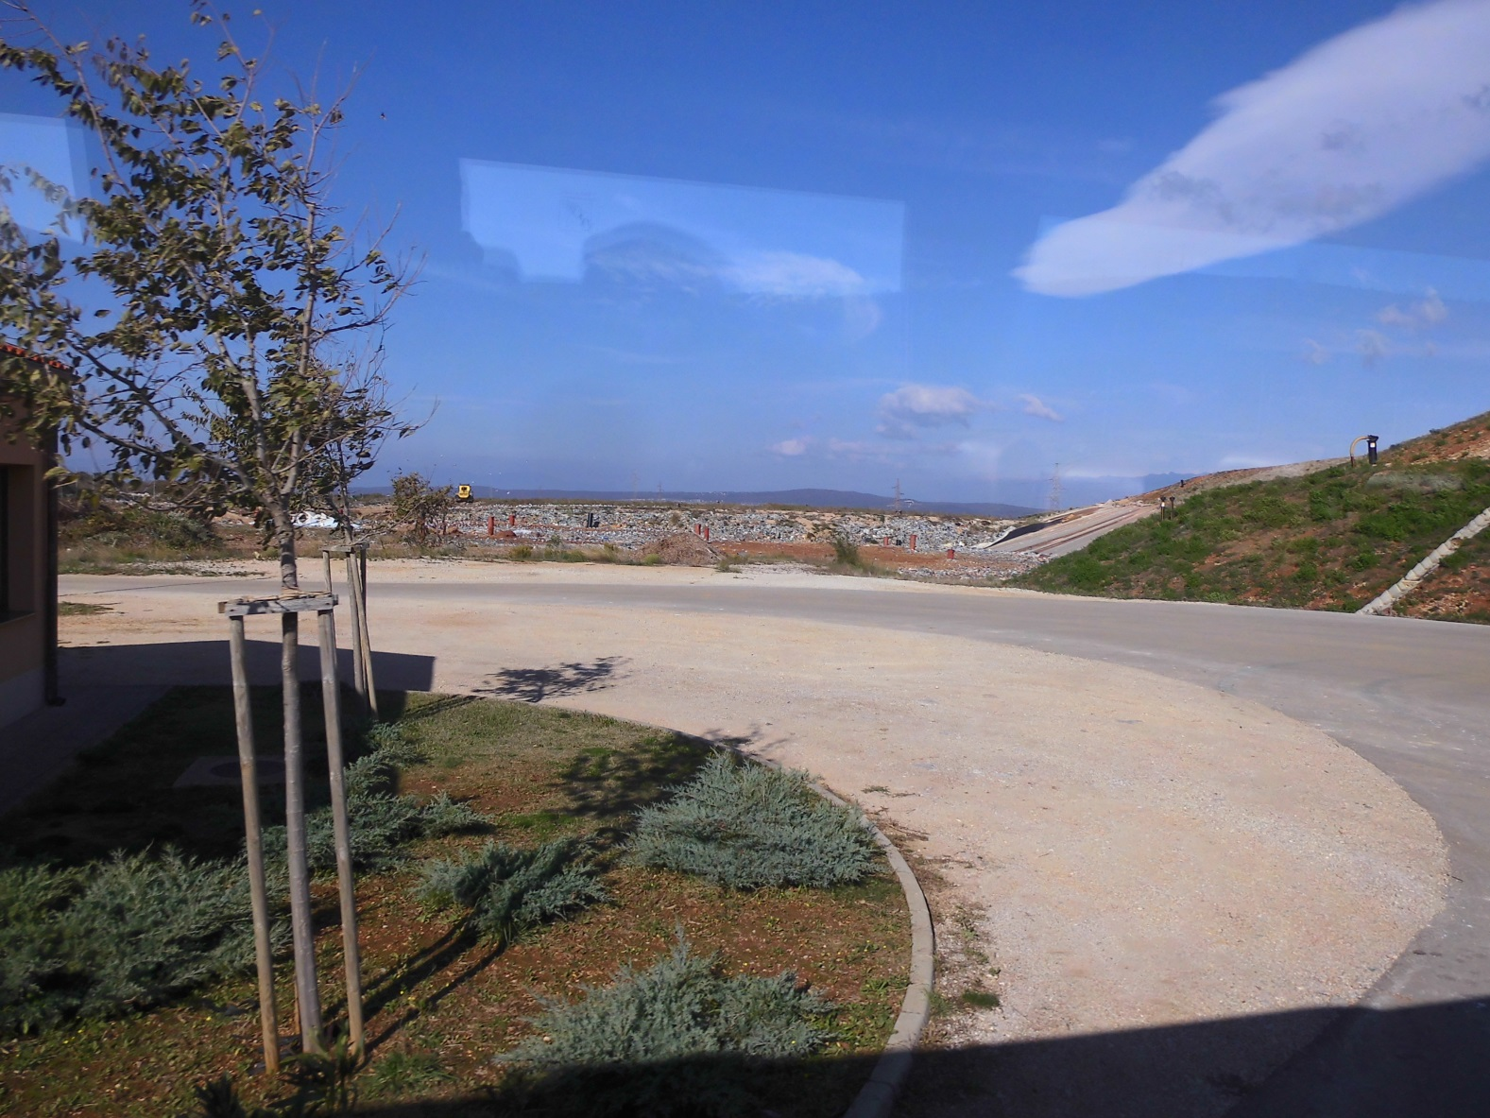
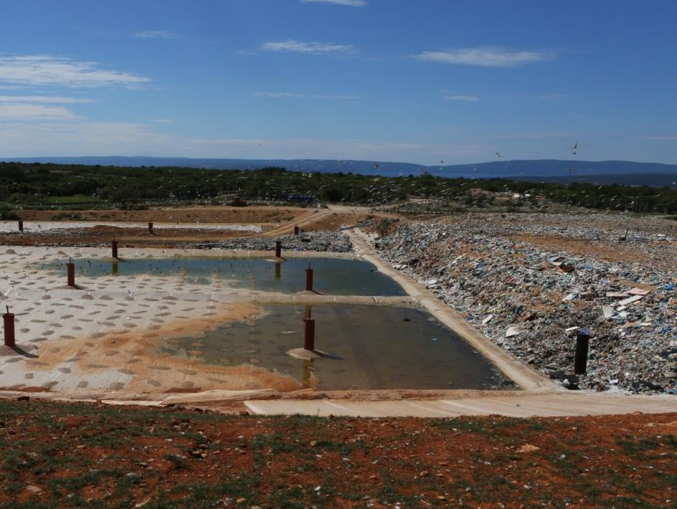
The central MSW landfill, Island of Krk, Republic of Croatia

Slide 4
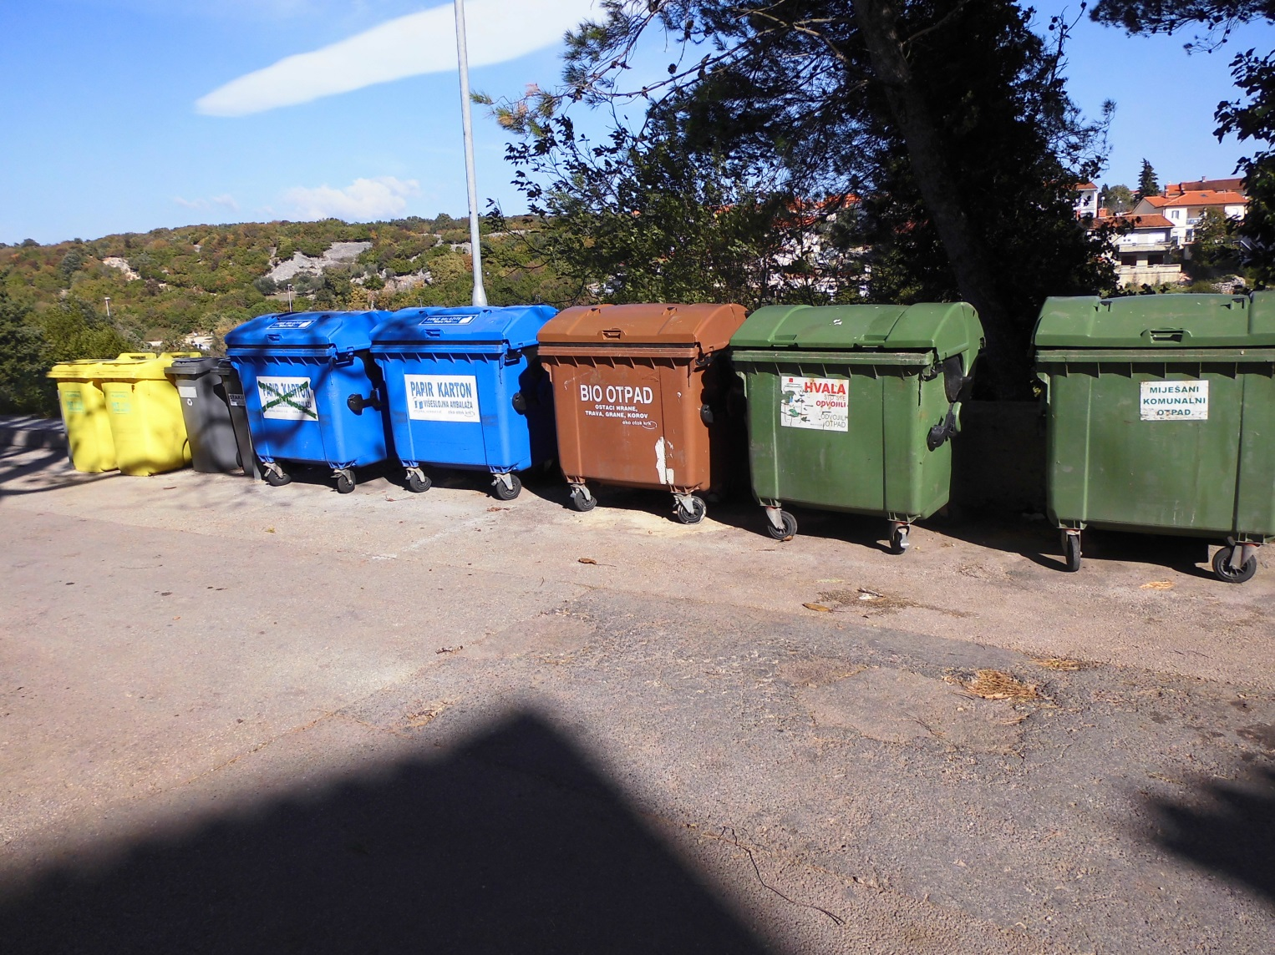
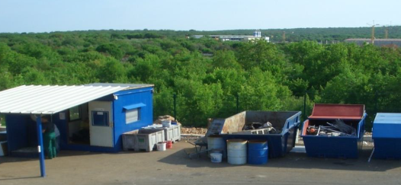
Curbside collection settings, Island of Krk, Republic of Croatia

Slide 5
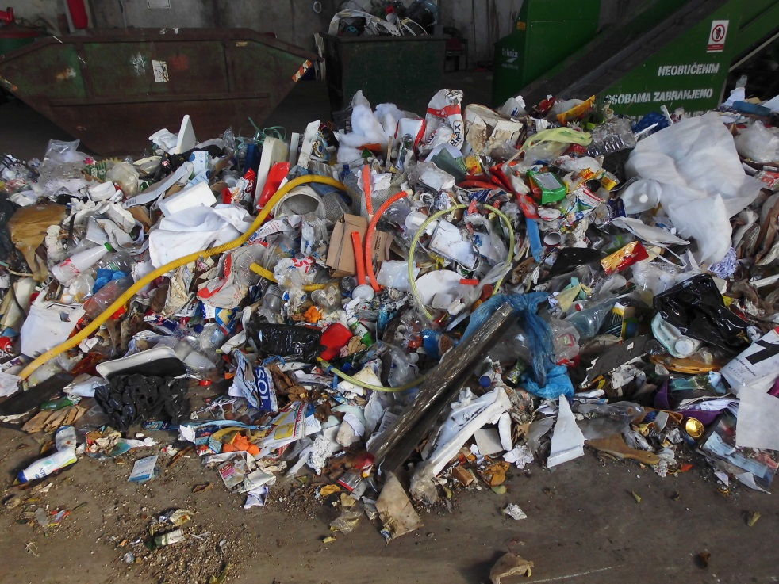
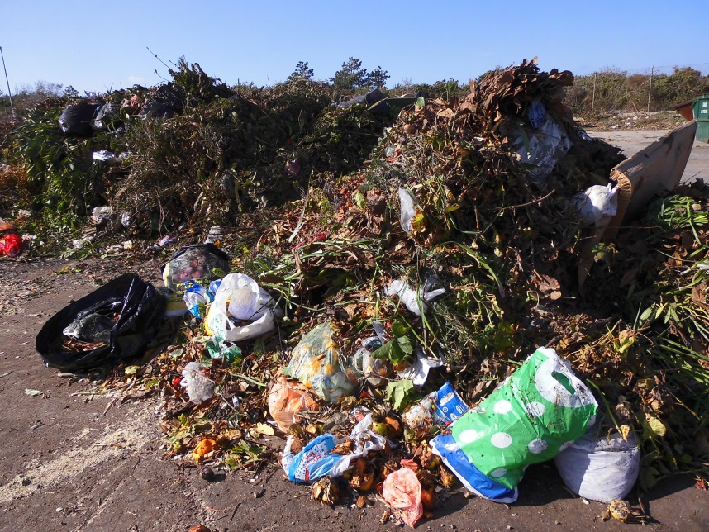
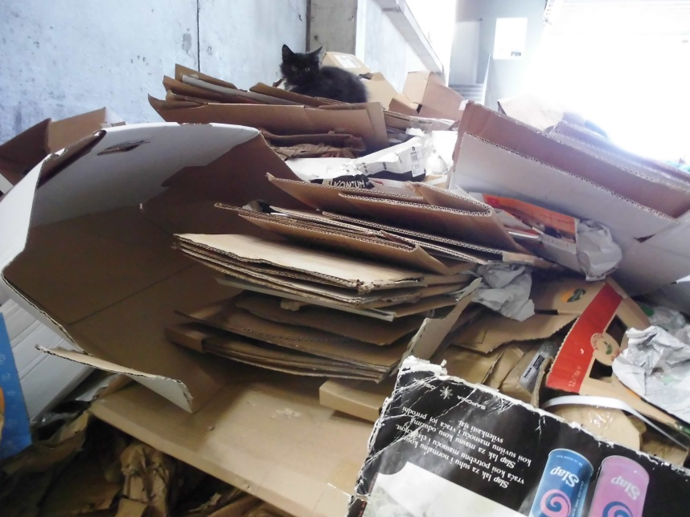
Main collected fractions, Island of Krk, Republic of Croatia
Plastic & metal fraction
Paper & board fraction
Biodegradable fraction

Slide 6
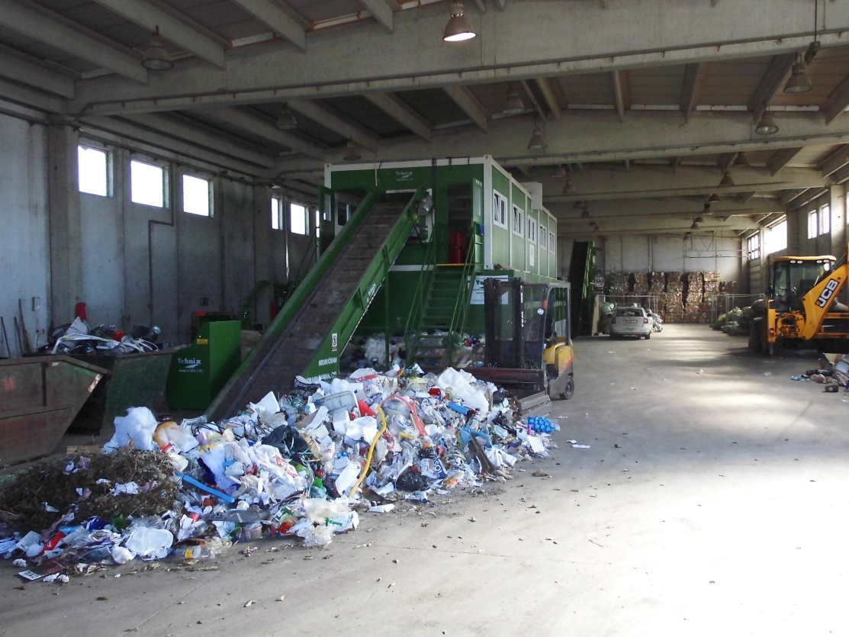
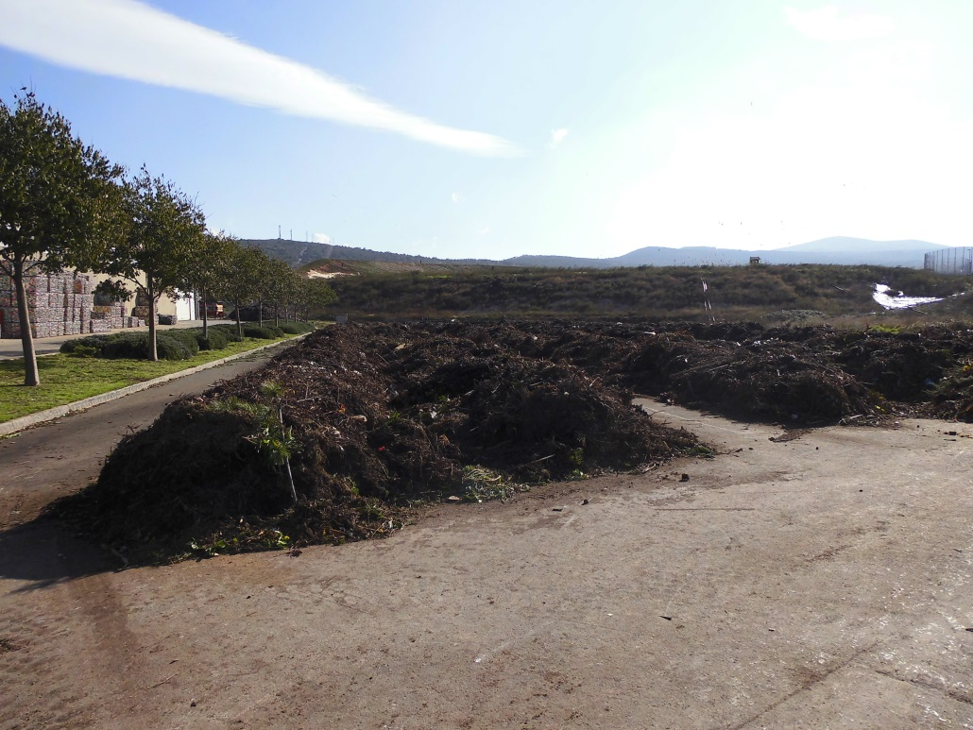
Material recovery and recycling, Island of Krk, Republic of Croatia
Biowaste composting
Material re-sorting

Slide 7
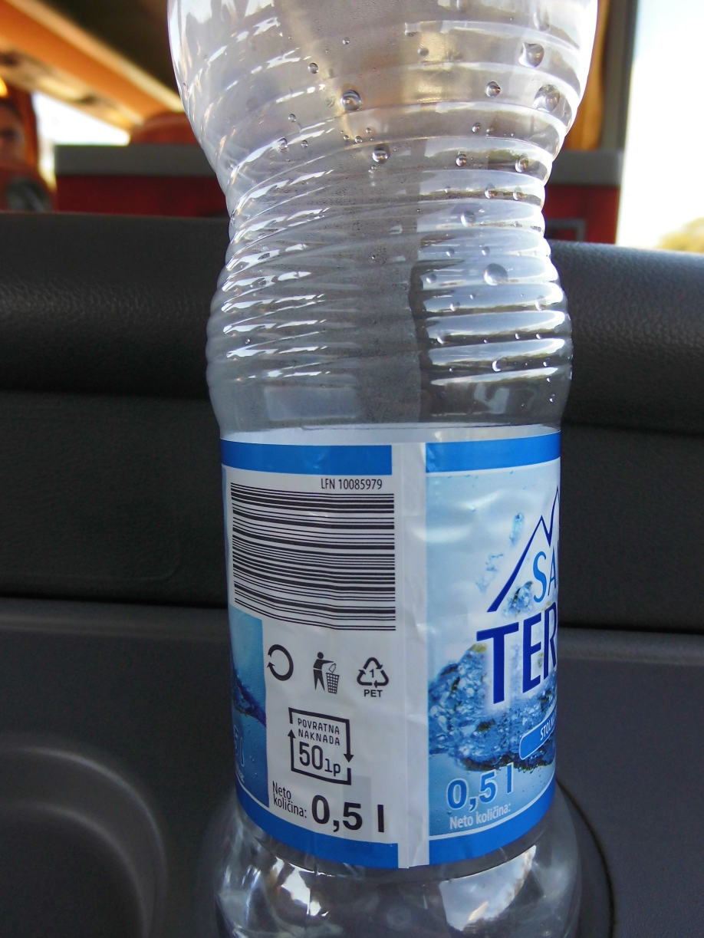
Supporting national measures
Extended producer responsibility (EPR)
example: Plastic bottle refund system

Slide 8
The facts so far
Costs to establish the (new features of the) system: 6.5 million EUR, (contributors: 40% State/EU; 40% Municipalities; 20% the Utility company)
Investments covered: - rehabilitation and modernization of the landfill area - acquisition and distribution of 7,000 waste containers in 1,400 spots across the island - establishment of recycling centre - new transportation equipment (as a very last step!)
Cost recovery is realized thru a household waste fee which by now also includes the (only temporarily occuppied) tourist appartments and weekend homes

Slide 9
The achievements so far

Slide 10
The achievements so far

Slide 11
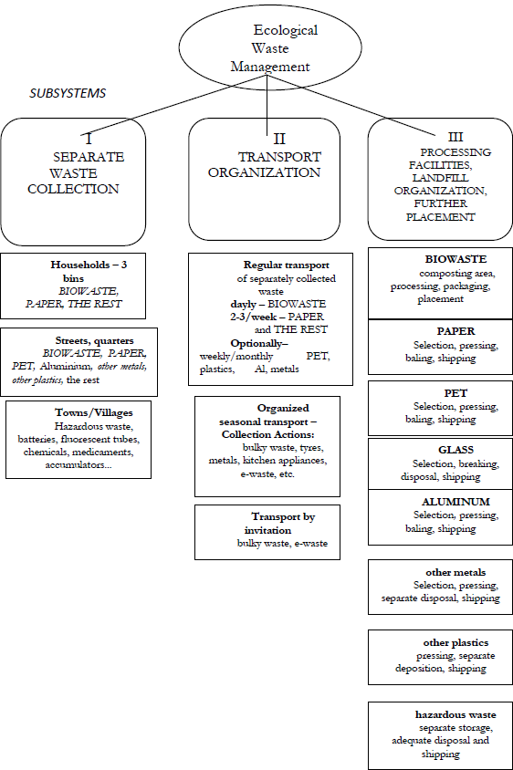
Everything started with a plan!
Organizational scheme (Uršić and Dobrović 2003: 22)

Slide 12
The association Ponikve.krk – Eko Otok Krk
all municipal governments on the island are co-owners of the Commercial Utility Services Association Ponikve Ltd. (7 municip. with initial shares from 23,4% [Krk town] to 6 % [Vrbnik municp.])
mayors/prefects from the different municipalities are also members of several different political parties, some extremely opposing to each other
governing body of the association is an Assembly of seven representatives from each municipality (the mayors/prefects) which have voting capacity corresponding to the share of their capital investment (so far only unanimous decisions were realized)
assembly provides guidance for the company's operations, decides on the long-term business plans, development and investment plans, annual plan of business, household fees, work rules and regulations, standards etc. and appoints the CEO
the members of the Assembly (and in addition the seven municipal councils on the island) gave their approval to the plan for a new MSW system

Slide 13
The starting situation
Even though the landfill looked pretty bad already, everybody was skeptical about such a new system working on the island: “We thought a thing like that can only function in Germany”. (Toljanić, personal interview2014)
Every municipality was faced with different problems that seemed more urgent.
Not all parts of the island were equally developed, some still did not have a developed water system
Different political orientations of the leading politicians
The plan and quality of the project (with tangible benefits for everybody) and perseverance by the promoters led to the mutual understanding and agreement of the municipalities!
The will of local politicians and local population’s acceptance made the system work!

Slide 14
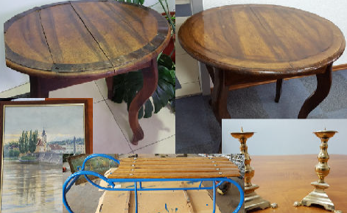
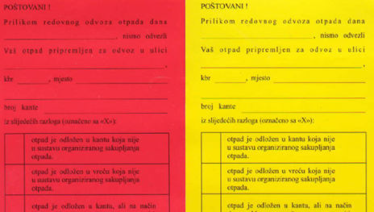
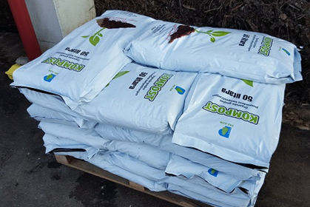
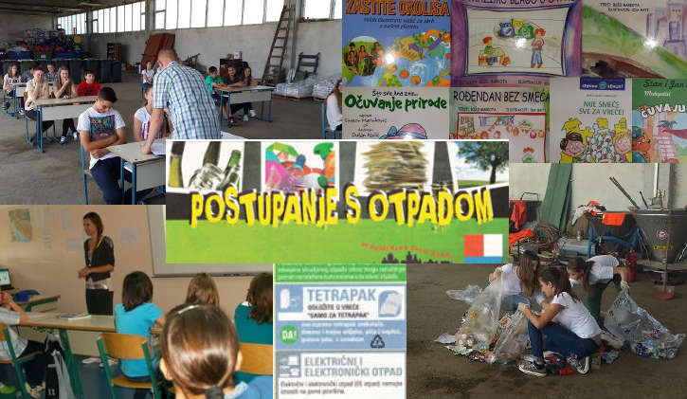
Other contributing aspects
Transparency (e.g. clear cost accounting)
Carrot and stick approach
e.g. - differentiated fees with social discounts (students - 20%, jobless families - 50%)
- awards and warning bills
- jobs (repair/refurbishment
- free compost
Education

Slide 15
An achievement to be proud of

Slide 16
Some ideas (of best practice from other places) to integrate in a WMP
‘Prevention of waste‘ - example ‘Advertising waste‘
photo material provided by ACR+

Slide 17
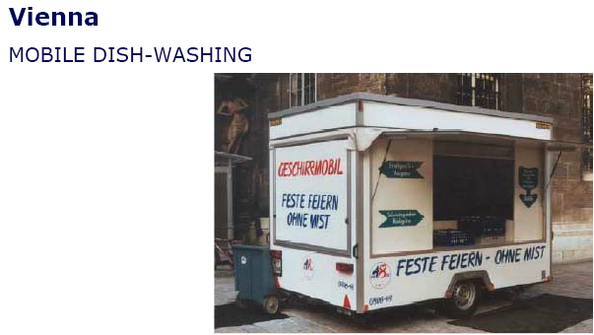
Some ideas (of best practice from other places) to integrate in a WMP
‘Prevention of waste‘ - example ‘One-way disposables‘
Practical implementation – Legal measures (ban on one-way products)
photo material provided by ACR+

Slide 18
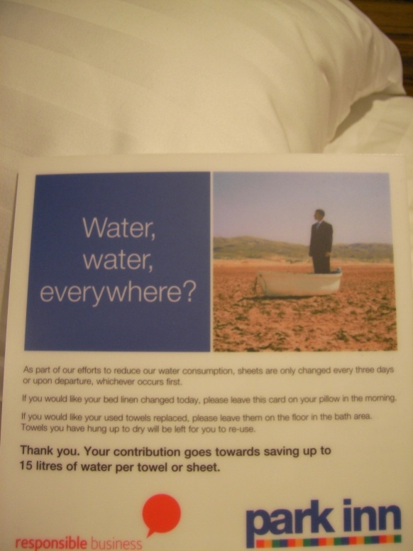
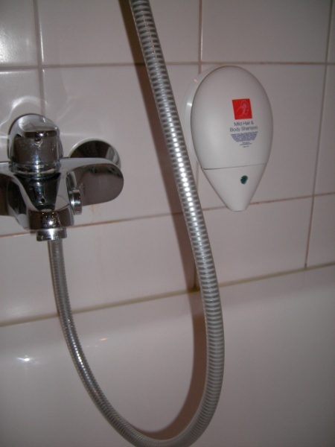
Some ideas (of best practice from other places) to integrate in a WMP
‘Prevention of waste‘ - example ‘Tourism industry‘
Practical implementation – Legal/economic pressure or voluntary agreements
Note: Easily adoptable for guest houses in project region, e.g. Shovi or Utsera resort

Slide 19
Some ideas (of best practice from other places) to integrate in the WMP
Reduction of waste – Repair initiatives
Combined benefits in the form of social, economic and environmental impacts
Repair centre
or
Repair guide

Slide 20
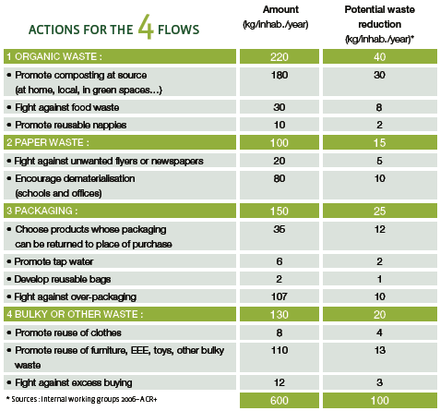
Some ideas (of best practice from other places) to integrate in the WMP
Reduction of waste – example of an integrated household waste reduction exercise in the EU
ACR+ initiative
= theoretical potential

