Slide 1
Integrated Solid Waste Management Kutaisi
– Accompanying Technical Training –
3rd Training
“Municipal Waste Management Planning“
Objectives in WM plan(ning) and format it may take
provided by Jan Reichenbach, International Expert for Solid Waste Management

Slide 2
The format a WM plan(ning) may take
Example:

Slide 3
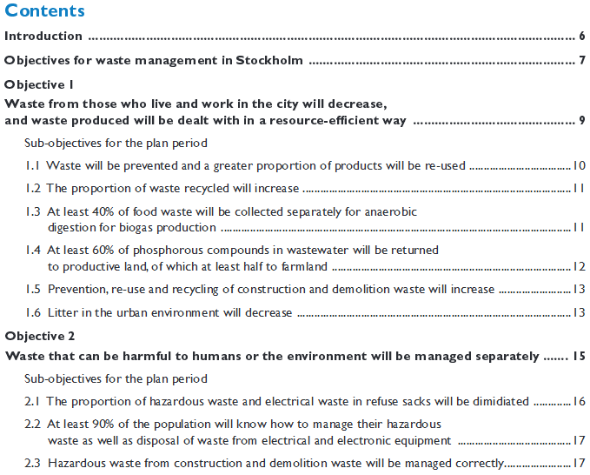
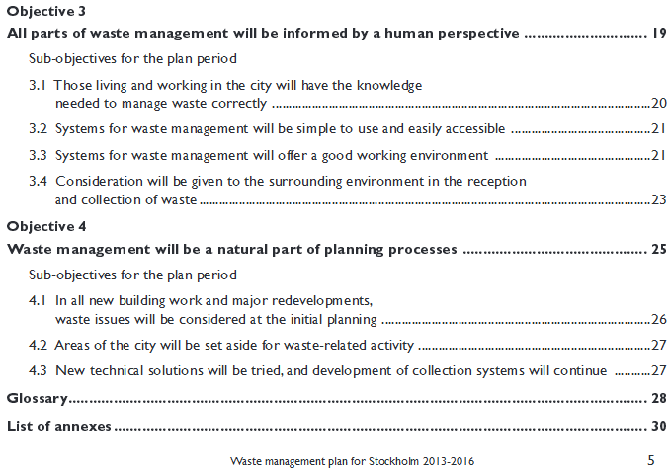
The format a WM plan(ning) may take
Q.: Do you note anything special in Stockholm’s WM plan?

Slide 4
Q.: Do you note anything special in Stockholm’s WM plan?
A.: It is completely objective driven (also reflected by its structure)!
Not forgetting: the understanding of the plan!

Slide 5
The format a WM plan(ning) may take
Q.: How about the other parts? A.: Yes, they are also there!

Slide 6
Setting municipal solid waste management objectives (in the WM plan)
Example:
Starts with a clearly formulated vision!

Slide 7
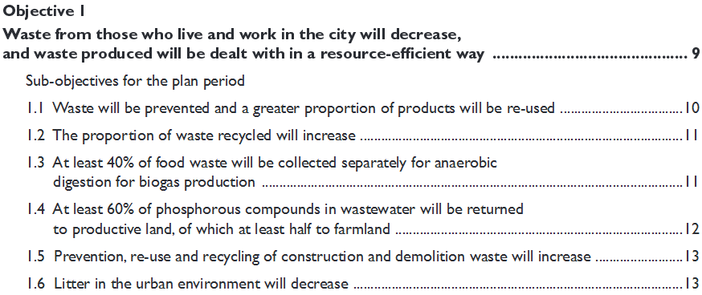
Setting municipal solid waste management objectives (in the WM plan)
Example: The Municipal Waste Management Plan of Stockholm 2013 - 2016

Slide 8
Setting municipal solid waste management objectives (in the WM plan)
Example: The Municipal Waste Management Plan of Stockholm 2013 - 2016

Slide 9
Setting municipal solid waste management objectives (in the WM plan)
Example: The Municipal Waste Management Plan of Stockholm 2013 - 2016

Slide 10
Setting municipal solid waste management objectives (in the WM plan)
Example: The Municipal Waste Management Plan of Stockholm 2013 - 2016

Slide 11
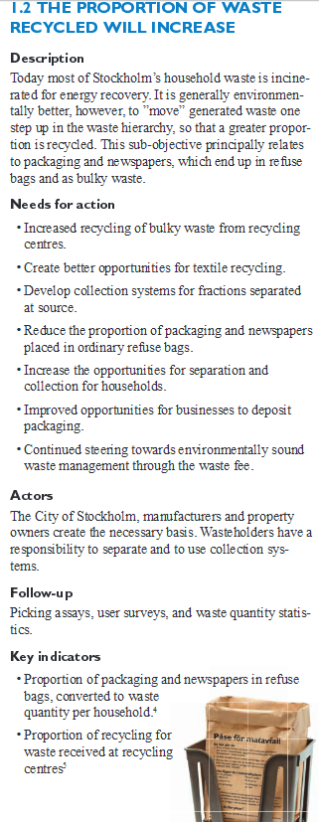
The format a WM plan(ning) may take
Example: The Municipal Waste Management Plan of Stockholm
General structure:
Principal objective(s)
Sub-objective(s)
Description of status, goals and application area
Identified actions
Identified actors
Monitoring / control tools
Measureable indicators

Slide 12
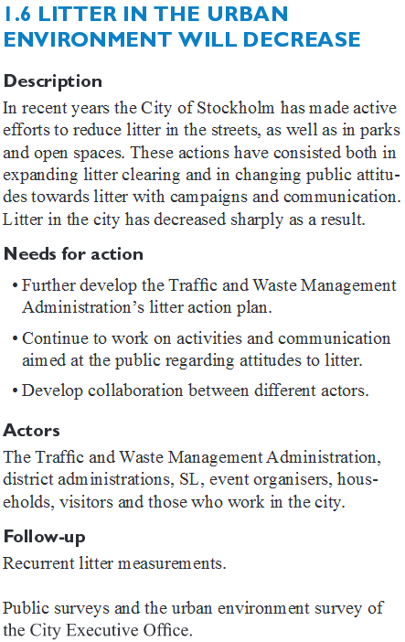
The format a WM plan(ning) may take
Example: The Municipal Waste Management Plan of Stockholm
Here: A tangible example for the project municipalities
One could add more details, e.g.
Municip. participated in campaign “Clean up Georgia“ in the years ..xy.., with ..xy.. participants, freed the forest from ..xy.. kg of litter.
Municip. installed a number of ..xy... additional waste baskets in the area of ....
Planning part must list the
concrete measures,
their estimated costs,
the schedule, and
responsibilities
of course.

Slide 13
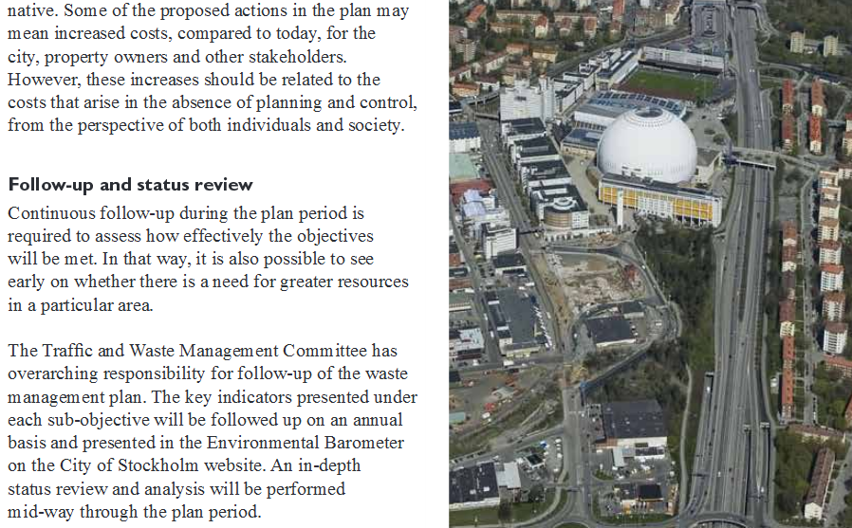
Other planning components, e.g. Review and Responsibilities
Example: The Municipal Waste Management Plan of Stockholm 2013 - 2016

Slide 14
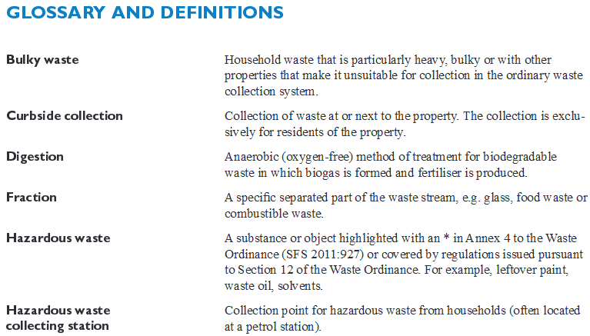
The format a WM plan(ning) may take
It is, among others, important to
set the links to legislation
make sure everybody understands the plan and each other!
Example: The Municipal Waste Management Plan of Stockholm

Slide 15
Is the example good? ....at least, all components are there!!
Vision & objectives
Status (part) information
Collection, Treatment, Disposal
Status and planning (part) information
Waste amounts/flows
Equipment/facilities used (or closed)
SWM capacities available
Review and proposed changes
Framework
Options assessment
Example

