Slide 1
Integrated Solid Waste Management Kutaisi
– Accompanying Technical Training –
Introductory Training
“Municipal Waste Management Planning“
Content and compilation of a Municipal WM plan
provided by Jan Reichenbach, International Solid Waste Management Expert, INTECUS GmbH

Slide 2
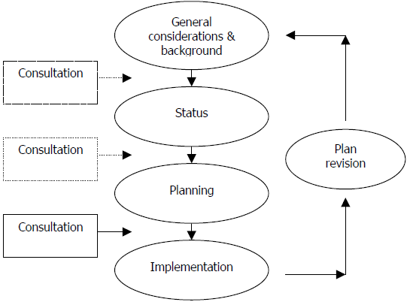
WM plan elaboration
Principal sections of WM plan
The process
Scope, Objectives, Background, Duration, Conditions, Limitations, Priorities/Visions
→ Starting Conditions (Status Part) e.g. quantities, quality, collection, equipment, recycling/disposal, actual(!) costs, cost recovery/access to funds, administrative/human capacities/technical qualifications (WC art. 13(4) a-d, g, h if relevant )
→ Planning part
planned measures, activities, investments + ways and time frame, responsibilities, estimated costs and financing sources (WC art. 13(4) e-i)
→ Procedure (when, how, with whom, what basis)

Slide 3
References/tools available
Guidelines:
Municipal Waste Management Plan Development Guideline prepared by ICMA and CENN January 30, 2015;
and its annexes, especially Annex 1 and 2
Recognized tools:
E.g. waste prognostic methods, etc. → Specific training sessions!
additionally helpful: Preparing a Waste Management Plan, a methodological guidance note, 2012, published by the European Commission, DG Environment; etc. see also guidelines of WB, UNEP and UNDP
Georgian examples:
Waste management action plan Kutaisi, 2015

Slide 4
Conditions
Area covered and conditions - Location, size, elevation, climate
Population - Number, age classes, social status/employment - also population dynamics/migration, seasonal changes (tourism)
Structures - dwelling/building structures, number/size of villages - relevant infrastructures (road/railroad connections) - local industries
Division of SWM responsibilities
Limitations
Note: Legal passage on the recognition of (temporary) limitations applying
e.g. lack of weight bridge to obtain waste quantities lack of personnel resources/qualification lack of equipment

Slide 5
Quantities and quality
Where generated (Sources of waste generation)
How much generated – How much collected (Not all what is generated is collected!) - Generation largely depends on source, individuals, season, social status - Collection largely depends on behavior, equipment, service
What is collected (waste types, material content)
How is collected quality - applies in the case of targeted (source separated) material streams
How does quality vary (seasonal change)

Slide 6
Collection
What services are offered - how can citizens dispose of waste - for which materials
What coverage is achieved (places/population connected/not connected to these services)
Collection settings (Number/capacities/arrangement of containers)
Collection frequency (How often is collected)

Slide 7
Equipment
What devices are available / are used - for collection (e.g. containers) - for pickup (e.g. lifter trucks) - for transportation (e.g. trucks) - for handling (e.g. bulldozer, crane, press)
How many of them
Where located/by whom used
How is state of equipment (what is planned usage period/when does it go out of operation)
What is the usable capacity

Slide 8
Costs/financing
What are the waste management-related cost positions - collection - transportation - disposal - personnel / administration
Relations with any other duties (e.g. water/sewage services, cemeteries)
Employed cost recovery mechanisms - fees charged - fee enforcement, defaults in payment
Other sources/funds for financing

Slide 9
Relations with WMP training concept
The phased WMP training approach | The procedure of the Georgian WMP guidline
Sensitization phase | Preparing to Develop the Plan
Mobilization | Planning Preparation Phase
 | Existing Conditions Status Phase
Enabeling | Options Assessment Phase
 | Plan Adoption Phase
follow up (= piloting + experience sharing) | Implementation Phase
 | Monitoring & Review Phase

Slide 10
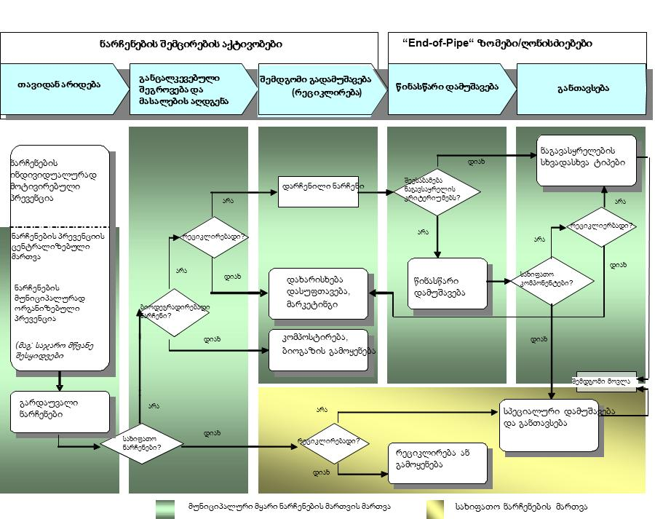
System overview / material flow (status / planning part)

Slide 11
“SMART” concept
Any identified targets and measures (in order to be) put in a WM plan must be:
Specific
Measurable
Achievable
Realistic
Time sensitive
only then monitoring and revision has a basis and makes sense

Slide 12
Interactive discourse
Let’s go thru the
Municipal Waste Management Plan Development Guideline
p. 13/14 (Basis for the MWM Planning)

