Slide 1
Integrated Solid Waste Management Kutaisi
– Accompanying Technical Training –
5th Training
“Municipal Waste Management Planning“
Collection logistics
Basics and planning advice
provided by Joerg Wagner, International Expert for Solid Waste Management

Slide 2
1. Tasks of Waste Collection Planning
Unproblematic implementation of waste collection systems
Security of investment
Economic efficiency (optimizing the workload of vehicles and staff)
Balancing of operations

Slide 3
2. Influencing factors on collection logistics
Specifications set by municipalities
  collection system
  collection frequency
  waste amount generated, type of bins, number of emptying, filling degree inside the bins, bulk density of waste in the bin
Geographical characteristics
  structure of dwelling, population density
  road infrastructure
  average driving speed, obstacles on the collection route
Collection work
  vehicle technology
  staff
  working time scheme
  other logistical features

Slide 4
2. Influencing factors on collection logistics
Specifications set by municipalities
  collection system
  collection frequency
  waste amount generated, type of bins, number of emptying, filling degree inside the bins, bulk density of waste in the bin
Geographical characteristics
  structure of dwelling, population density
  road infrastructure
  average driving speed, obstacles on the collection route
Collection work
  vehicle technology
  staff
  working time scheme
  other logistical features

Slide 5
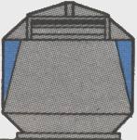


2. Influencing factors on collection logistics
Specifications set by municipalities
  collection system
  determination of collection frequency
Collection system
Type of bin
Vehicle technology
Bring system
Depot container
Roll-off tipping vehicle with a crane
1,5 -3,5 m³
Pick-up systems
Large refuse contai-
ners 550 - 1.100 l
Rear end loader,
Front end loader,
Large refuse contai-
ners 60 - 240 l
Side loader
Rear end loader
Collection of bundles
with large feeding device

Slide 6
2. Influencing factors on collection logistics
Specifications set by municipalities
  collection system
  collection frequency
  waste amount generated, type of bins, number of emptying, filling degree inside the bins, bulk density of waste in the bin
Geographical characteristics
  structure of dwelling, population density
  road infrastructure
  average driving speed, obstacles on the collection route
Collection work
  vehicle technology
  staff
  working time scheme
  other logistical features

Slide 7
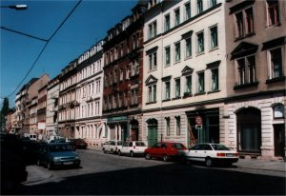
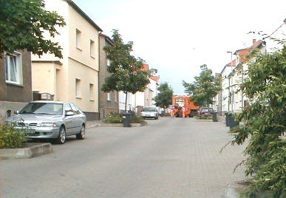
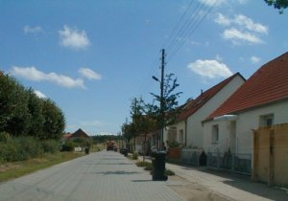
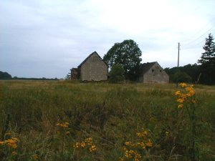
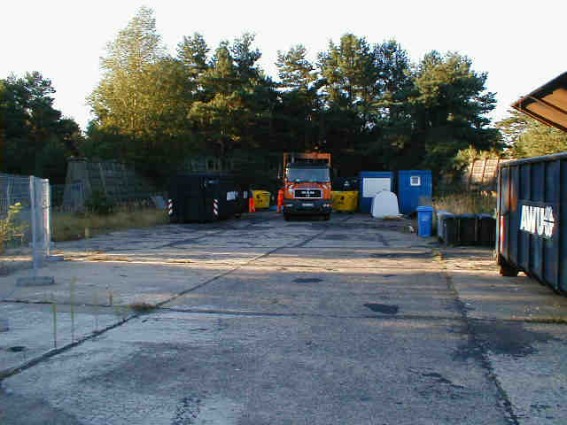
2. Influencing factors on collection logistics
Geographical characteristics
  structure of dwelling, population density
Large housing estates DS 1
DS 2 Closed apartment building structure
Opened apartment building structure DS 3
DS 4 Single- or double-family housing area
Scattered rural dwelling DS 5
Commercial and industrial areas

Slide 8
2. Influencing factors on collection logistics
Specifications set by municipalities
  collection system
  collection frequency
  waste amount generated, type of bins, number of emptying, filling degree inside the bins, bulk density of waste in the bin
Geographical characteristics
  structure of dwelling, population density
  road infrastructure
  average driving speed, obstacles on the collection route
Collection work
  vehicle technology
  staff
  working time scheme
  other logistical features

Slide 9
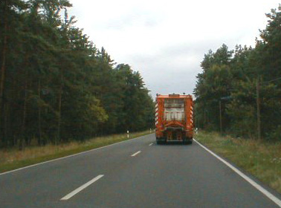
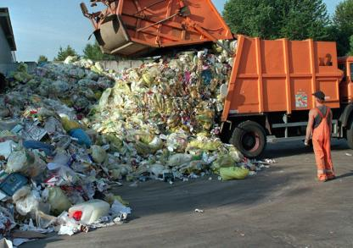
2. Influencing factors on collection logistics
Collection work
  characteristic time steps
Collection
Transportation
Emptying
Set-up time, breaks

Slide 10

2. Influencing factors on collection logistics
Collection work
  collection time
Emptied containers:
Collection time:
Waste amount collected:
5
187 sec.
125 kg
Collection point
25 kg
25 sec.
Interim transport
16 sec.
Collection point
50 kg
36 sec.
Interim transport
16 sec.
Collection point
25 kg
25 sec.
Interim transport
28 sec.
Collection point
25 kg
25 sec.
Interim Transport
16 sec.
No. 1
No. 2
No. 3
No. 4
No. 5
Stretch of road:
length 100 m, through road, dwelling structure 4

Slide 11
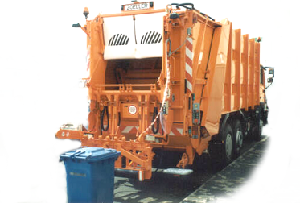
2. Influencing factors on collection logistics
Collection work
  tipping time
example:
- residual waste
- bin size 60-240 ltr.
- dwelling structure 4
Tipping time per bin [sec.]
Number of bins per collection point
Rear-end loader 1+2
Rear-end loader 1+1
Side loader 1+0

Slide 12
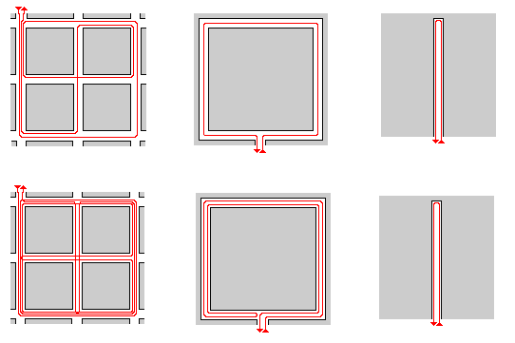
2. Influencing factors on collection logistics
Collection work
  interim transport time
Through road
Ring road
Dead end
both side collection
1,5
1,0
2,0
one side collection
2,6
2,0
2,0

Slide 13
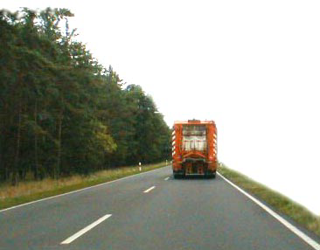
2. Influencing factors on collection logistics
Collection work
  transport time to the landfill or transfer station
Calculation of transport time by use of average speed
Type of road
Highway
National road
Rural road
Innercity main road
DS 4/5
DS 1/2/3
Average speed [km/h]

Slide 14
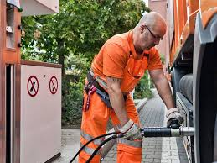
2. Influencing factors on collection logistics
Collection work
  further time requirements
Emptying time at landfill/transfer station
optional: Time for exchange of swap containers
Set-up time (preparation of the truck, refueling), breaks

Slide 15
2. Influencing factors on collection logistics
Collection work
  Example of collection of large refuse containers vs. depot containers
Interim transport
Transport to landfill
Collection time
Collection time [h]
Rear-end loader 1+1 Side loader 1+0 Roll-off tipping vehicle

