Slide 1
Integrated Solid Waste Management Kutaisi
– Accompanying Technical Training –
„waste generation and separate collection”
March 22 - 23, 2017
Presented by: The SWM training expert Mr. René Boesten, PEM

Slide 2
Estimation of Generated Waste Amounts
1.a) Calculation on the basis of the number of inhabitants or commercial activities by the use of specific parameters
Creation of specific parameters for
inhabitants
public services (hospitals, schools, kindergartens)
commercial activities (offices, restaurants, cinemas, department stores, supermarkets, a.o.)
Calculation of the waste amounts according to the real figures of the inhabitants or specific activities in the municipality

Slide 3
Estimation of Generated Waste Amounts
Creation of specific parameters for
Inhabitants
FS Kutaisi | Waste per day per person | Waste per year per person
Regional capital | 0.85 | 310
Urban > 10,000 | 0.70 | 256
Urban < 10,000 | 0.55 | 201
Rural | 0.40 | 146
Real data 2015 | Waste delivered at the landfill (ton) | Population 2015 | Collection efficiency | total waste | Waste per day per person | Waste per year per person
Kutaisi city | 54,000 | 147,635 | 90% | 48,600 | 0.90 | 330

Slide 4
Estimation of Generated Waste Amounts
Long term forecast:
Inhabitants
Total population from Georgian statistics office
Population forecast:
Economic growth: 1% growth = 0.3% more waste
Tourism waste: 1 overnight stay = waste/day from resident
Pop growth rates | per year
Rural | -0.5%
Urban | 2.0%

Slide 5
Estimation of Generated Waste Amounts
1.a) Calculation on the basis of the number of inhabitants or commercial activities by the use of specific parameters
Example from Bulgaria:
№ | Object | Accumulation norm |  |  |  | kg/m³
 |  | Yearly |  | Daily
 |  | kg | l | kg | l
1. | Hospital – 1 bed | 230 | 700 | 0,63 | 1,9 | 330
2. | Policlinics 1 person | - | - | 0,1 | 0,4 | 250
3. | Hotels - 1 person | 80 | 400 | 0,22 | 1,1 | 200
4. | Dormitory – 1 person | 100 | 330 | 0,28 | 0,93 | 300
5. | Kinder-garden – 1 bed | 70 | 235 | 0,19 | 0,78 | 300
6. | School – 1 pupil | 20 | 90 | 0,06 | 0,3 | 320
7. | Institute – 1 pupil | 26 | 120 | 0,09 | 0,4 | 220
8. | Cinemas – 1 seat | 20 | 90 | 0,06 | 0,3 | 220
9. | Offices – 1 person | 50 | 250 | 0,14 | 0,7 | 200
10. | Restaurant – 1 meal | - | - | 0,06 | 0,2 | 300
11. | Kitchenette – 1 meal | - | - | 0,03 | 0,1 | 300
12. | Department store for food – 1 m² | 120 | 460 | 0,33 | 1,27 | 260
13. | Department store for industrial goods – 1 m² | 30 | 150 | 0,08 | 0,4 | 200
14. | Tailor office – 1 person | 100 | 250 | 0,27 | 0,68 | 400
15. | Warehouses – 1 m² | 35 | 70 | 0,09 | 0,19 | 500
16. | Markets – 1 m² | 18 | 36 | 0,06 | 0,12 | 500

Slide 6
Estimation of Generated Waste Amounts
Long term forecast:
Waste from inhabitants
Waste from tourists
Waste from public services (hospitals, schools, kindergartens)
Waste from streetcleaning and markets
Waste from commercial activities (offices, restaurants, cinemas, department stores, supermarkets, etc.)

Slide 7
Estimation of Generated Waste Amounts
Long term forecast and waste disposal costs:
Waste from:
inhabitants => paid via waste service fee
tourists => paid via contracts with hotels and service fee
public services => paid via contracts or service fee
streetcleaning and markets => paid via waste service fee
commercial activities => paid via contracts or service fee

Slide 8
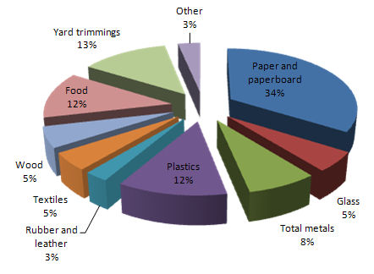
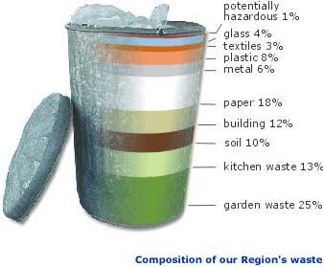
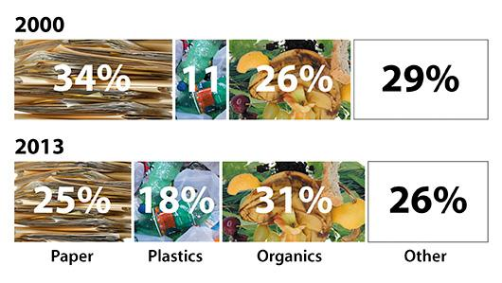
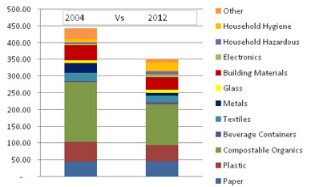
Analysis of Waste Composition
How to get figures on Waste Composition?

Slide 9
Analysis of Waste Composition
What it is good for?
to know material composition (recyclable components, harmful components)
to assess/be aware of treatment/safety needs
to understand where prevention should/can be exercised
to assess feasibility and efficient ways of separate collection
to determine other management measures and monitor effectiveness
to get note on changes/trends in the waste generation
to support waste estimations and/or verify available data
to educate people

Slide 10
Waste prognosis – meaning and importance
What it is good for?
to know future waste amounts generated
to plan waste collection and waste treatment capacities
to understand the effects of waste management measures
to assess feasibility and efficient ways of separate collection
to get note on changes/trends in the waste generation
to educate people

Slide 11
Waste calculation
Total waste =
Waste per capita * total population + non-household waste + tourism waste
Total waste =
Waste delivered at the landfill

Slide 12
 | Waste delivered at the landfills (ton) | Waste calculated (tons)
Baghdati Municipality | 1,949 | 2,481
Chiatura Municipality | 2,423 | 6,058
Kharagauli Municipality | 845 | 2,239
Kutaisi Municipality | 54,442 | 51,731 | More non-household waste?
Sachkhere Municipality | 6,664 | 7,514
Samtredia Municipality | 8,396 | 11,326
Terjola Municipality | 2,269 | 4,089
Tkibuli Municipality | 2,227 | 3,519
Tskaltubo Municipality | 4,836 | 9,639
Zestaponi Municipality | 7,105 | 9,019
Vani Municipality | 1,331 | 2,818
Khoni Municipality | 2,716 | 3,743

Slide 13
 | Waste delivered at the landfills (ton) | Waste calculated (tons)
C. Ambrolauri | 1410.15 | 305
Ambrolauri Municipality |  | 1,361
Oni | 1185.1 | 652
Tsageri | 1079.4 | 912
Lentekhi | ?? | 1,194 | What happens with the waste?

Slide 14
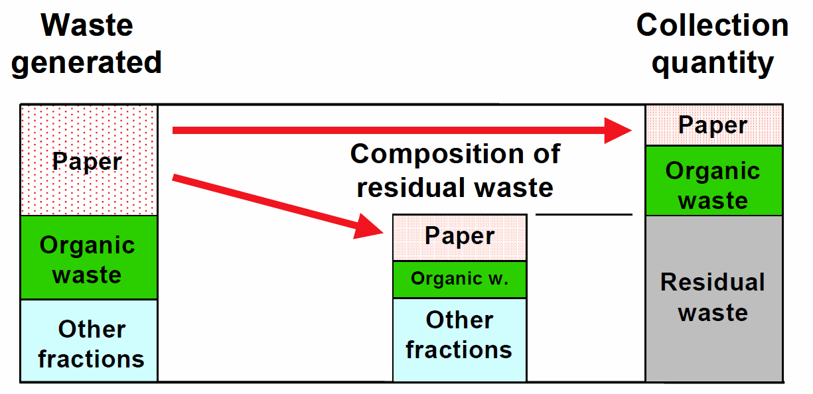
Waste prognosis – meaning and importance
Approaching the subject of separate collection
must be addressed in quality and quantity in your WM plan (2019 deadline!)
due to 2019 deadline a matter of prognosis
Source: Boer et al. (2005): Waste Management Planning and Optimization

Slide 15
Impact of separate collection
Waste composition:
Waste categories | Minimum (%) | Maximum (%)
Paper and cardboard | 12.2 | 16.7
Glass bottles | 4.8 | 6.4
Scrap metal | 1.5 | 2.3
Polyethylene / Plastics | 13.6 | 17.5
Sanitary paper/diapers | 4.8 | 8.3
Textiles | 5.4 | 5.9
Organic | 38.6 | 42.7
Construction waste | 4.0 | 4.1
Hazardous household waste | 1.4 | 1.7
Leather/rubber | 1.7 | 2.7
Other | 1.4 | 2.1
Loss (humidity) | 0.3 | 1.5

Slide 16
Impact of separate collection
Estimated amounts of recyclables in municipal waste
Estimated amounts of recyclables in municipal waste | Paper (t/a) |  | Glass (t/a) |  | Plastics (t/a)
 | lower limit | upper limit | lower limit | upper limit | lower limit | upper limit
Imereti | 12,447 | 20,596 | 4,852 | 7,837 | 13,885 | 21,603
Racha-Lechkhumi | 569 | 1,073 | 222 | 408 | 635 | 1,126

Slide 17
Impact of separate collection
Targets for collection
 | 2020 | 2025 | 2030
Paper | 30% | 50% | 80%
Glass | 20% | 50% | 80%
Plastic | 30% | 50% | 80%
waste composition
paper | 12.2% | 16.7%
glass | 4.8% | 6.4%
plastics | 13.6% | 17.5%
bio | 38.6% | 42.7%

Slide 18
Impact of separate collection
 |  | Waste calculated (tons) | 2020 | 2025 | 2030 | difference
Baghdati Municipality |  | 2,481 | 2,266 | 2,102 | 1,874
Chiatura Municipality |  | 6,058 | 5,662 | 5,131 | 4,575
Kharagauli Municipality |  | 2,239 | 2,035 | 1,896 | 1,691
Kutaisi Municipality |  | 51,731 | 49,033 | 43,816 | 39,067
Sachkhere Municipality |  | 7,514 | 7,044 | 6,364 | 5,674
Samtredia Municipality |  | 11,326 | 10,664 | 9,593 | 8,553 | -25%
Terjola Municipality |  | 4,089 | 3,792 | 3,463 | 3,088
Tkibuli Municipality |  | 3,519 | 3,251 | 2,981 | 2,658
Tskaltubo Municipality |  | 9,639 | 9,062 | 8,164 | 7,279
Zestaponi Municipality |  | 9,019 | 8,473 | 7,639 | 6,811
Vani Municipality |  | 2,818 | 2,585 | 2,387 | 2,128
Khoni Municipality |  | 3,743 | 3,464 | 3,171 | 2,827

Slide 19
Impact of separate collection
 |  | Waste calculated (tons) | 2020 | 2025 | 2030 | difference
C. Ambrolauri |  | 305 | 199 | 258 | 230
Ambrolauri Municipality |  | 1,361 | 1,202 | 1,153 | 1,028
Oni |  | 652 | 529 | 553 | 493 | -25%
Tsageri |  | 912 | 775 | 772 | 689
Lentekhi |  | 1,194 | 1,043 | 1,012 | 902

Slide 20
Impact of separate collection
Biowaste
Kitchen, gardens, parks
Composition: urban: 35 - 40%
Rural: 45 – 60%
Collection / prevention
Urban: 30 - 40% (mainly collection)
Rural: 50 – 60% (mainly prevention)

