Slide 1
Integrated Solid Waste Management Kutaisi -
State of the Art, outlook to coming 2 years
Third Meeting with PR Officers of Municipalities in Kutaisi -
13 February 2019

Slide 2
Main topics
Waste Management System in Georgia – now and then
The new landfill for Imereti, Racha-Lechkhumi and Kvemo Svaneti

Slide 3
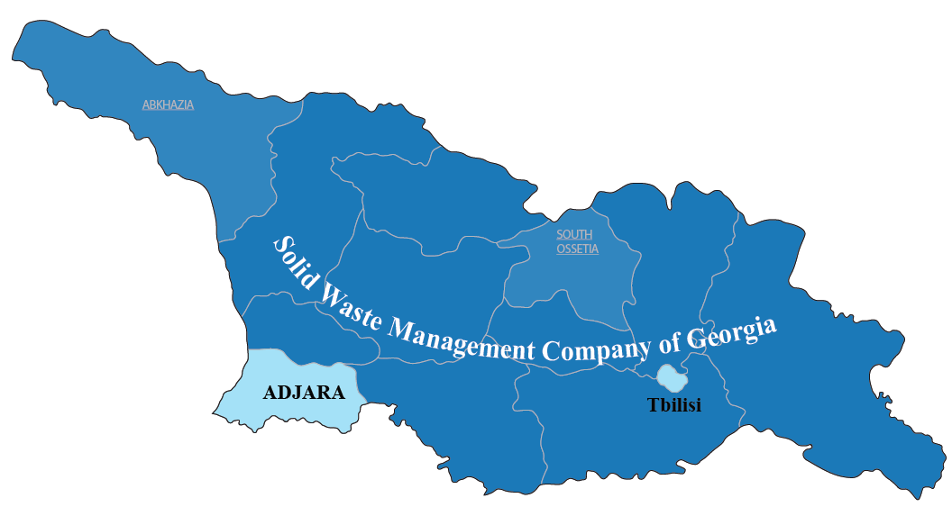
Three main landfill operators
Solid Waste Management Company of Georgia – 54 landfills in 9 regions
Municipality of Tbilisi – landfill close to Lilo
Autonomous Region of Adjara – landfills in Batumi and Kobuleti

Slide 4
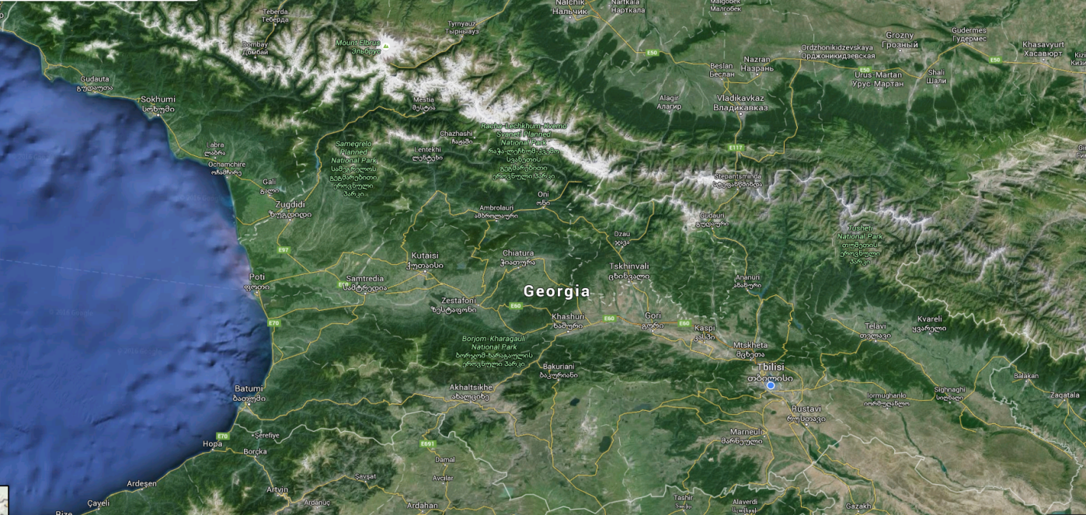
From municipal landfills to regional landfills
National Waste Management Code
National Waste Management Strategy
National Waste Management Action Plan
2023
2019
54 + 3 existing municipal landfills
8 planned regional sanitary landfills
Out of the 54 landfills, SWMCG has reconditioned and secured 31, 23 were closed and 5 transfer stations were built
SWMCG will run 7 regional landfills.
One regional landfill will serve Adjara (AR)

Slide 5
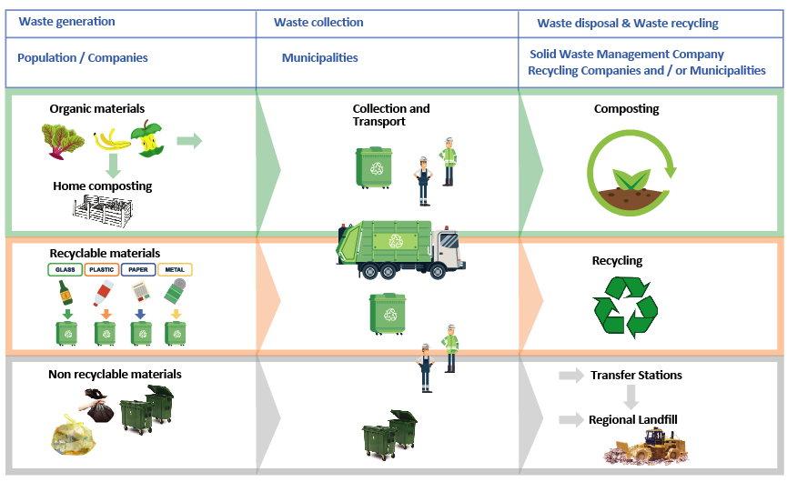
The new waste management system - Main responsibilities of the involved parties

Slide 6
Closure of all municipal landfills

Slide 7
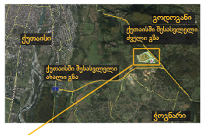
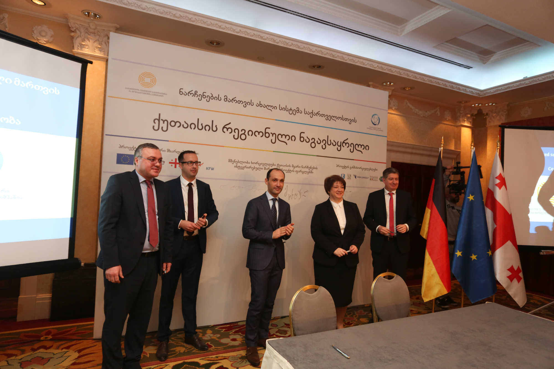
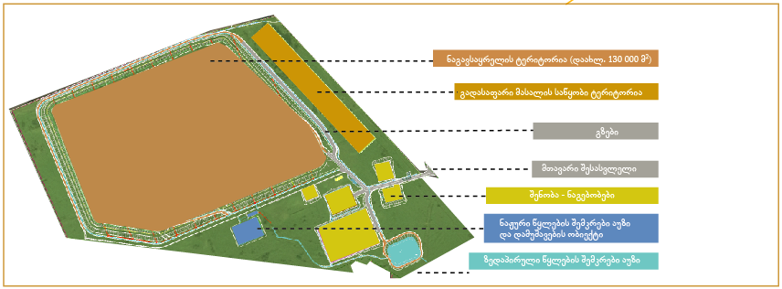
The new “Kutaisi Regional Landfill”
All legal requirements are accomplished
The official name of the landfill is 'Kutaisi Regional Landfill'
The consortium Sade-Riko will carry out the construction works
The new landfill should enter in operation still in 2020
The new landfill is environmentally friendly

Slide 8
The new “Kutaisi Regional Landfill”
https://youtu.be/OuadntHQuLk

Slide 9
Thank you for your attention

