Slide 1
DAY 1 | September 13, 2017
 | Topic |  | Speaker
13:30 – 14:00 | Registration
14:00 – 14:15 | Welcome and introduction to the program | Jan Reichenbach René Boesten
14:15 – 15:30 | Progress review (consultative visits, homework, work drafts planning process) Presentation of progress/achievements | Levan Zazadze Jan Reichenbach Mun. work groups
15:30 – 16:00 | Coffee break
16:00 – 17:00 | Answers/conclusions upon the issues raised in the consultative meetings (e.g. waste service charge, when is a service a service, special wastes) | René Boesten Jan Reichenbach
17:00 – 17:30 | Activities of the Solid Waste Management Company relevant for SWM planning by municipalities (closure of dumpsites, new regional landfill, gatefee, transfer stations and amenity centers, special wastes management) | Giorgi Mathiasvili
17:30 – 17:50 | Planning assistance re. amenity centers | Jan Reichenbach
17:50 – 18:15 | Finalisation of the WM plan (Objectives and plans, stakeholders involvement) | René Boesten Anano Asatiani

Slide 2
Day 2 | September 14, 2017
9:30 – 10:00 | Registration
10:00 – 10:30 | Recap of day 1 | René Boesten Hakan Mat
11:00 – 12:30 | PA actions Activities/progress since last training Specific topics to be covered (quality of services, costs for the service, separate collection and the need to reduce waste going to the landfill) | Mun. work groups Moderation: Anano Asatiani Ulrich Roth
12:30 – 13:30 | Lunch break
13:30 – 14:45 | PA actions –continuation- | Ulrich Roth Anano Asatiani
00
00
14:45 – 15:30 | Conclusions and follow up program | René Boesten, Jan Reichenbach

Slide 3
Integrated Solid Waste Management Kutaisi
– Accompanying Technical Training –
8th Training
“Municipal Waste Management Planning“
Progress review
Jan Reichenbach, Levan Zazadze
Expert team Solid Waste Management

Slide 4
Schedule for WMP process
Sensitiz. | Mobilization | Enabling |  | Finalization
kick-off | Status Part |  | Planning Part
Here we are
Nov’16
Dec’16
Feb’17
Mar’17
Apr’17
May’17
Jun’17
Jul’17
Sep’17
Nov’17
Waste quantity assessment/prognosis
Cost & revenue status re. SWM
Legislation followup
Collection planning
Logistics planning
Equipment planning
Presentation mobilization results
& existing conditions analysis
General data issues,
Waste data issues,
Overall content issues
Association issue
Investment planning
Fee planning
Information management
PR/awareness planning

Slide 5
Consultative visits to muncipalities
Three municipal visits on WMP in April
Kutaisi, Tsageri, Lentekhi
Seven municipal visits on WMP in June
Sachkhere, Chiatura, Zestaponi, Samtredia, Kutaisi, Tkibuli, Ambrolauri
Ten municipal visits on WMP in July
Sachkhere, Chiatura, Tskaltubo, Samtredia, Kharagauli, Tkibuli, Vani, Tsageri, Lentekhi, Oni
Relevance of issues:
Municipalities: implementation/affordability of charging
‘special wastes’
dealing with commercial entities/tourism
Training team: pending (mandatory) content / checklist /CENN methodology
work group functionality
high level commitments (charging, dumpsite closure, source separation)
public and stakeholder involvement

Slide 6
State of WM planning
Returns of checklist incomplete (10 out of 15! , homework!)
Only few updated draft WM plans received (6 municip.)
Quality evaluation/support by training team thus facing limitations
“Does quality level suffice?? – without progress since June NOT!”
No information about planned activities with stakeholders/the public
(experts not wanted/needed?)

Slide 7
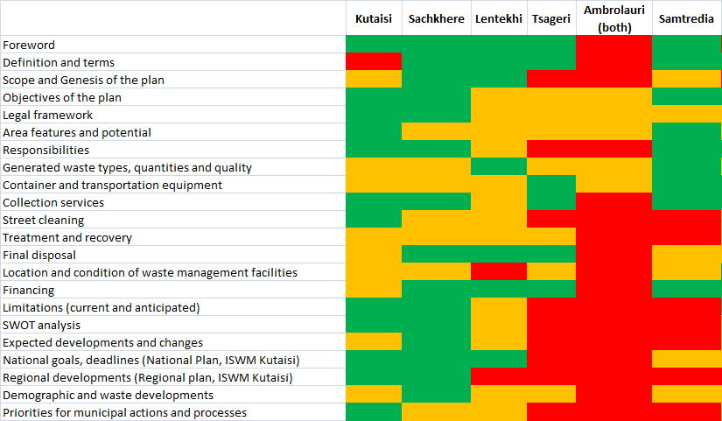
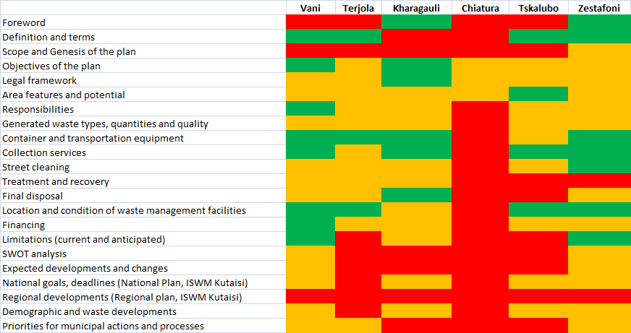
Review of the draft WM chapters – May/June
12 draft WM plans (mainly information re. status quo part)
deficits re. relevance and precision of data
rather vague visions for planning

Slide 8
Review of the draft WM chapters – updates till August
Tkibuli
Oni
Latest update: also the Municipality of Bagdati prepared a draft WM plan lately

Slide 9
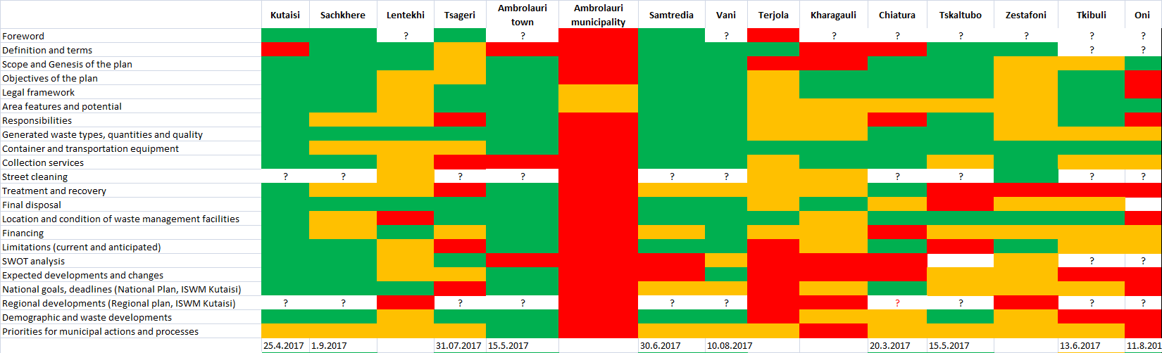
Review of the draft WM chapters – evaluation per checklist
by now 16 draft WM plans
visible improvements based on self-assessment (mainly content-oriented - see blue circles for most apparent improvements made since June)
Quality aspect should move to the fore (limited assessment possibilities!)
Focus must be laid on coherent and reasoned strategies/actions further to content improvements (of varying intensity)

Slide 10
Integrated Solid Waste Management Kutaisi
– Accompanying Technical Training –
8th Training
“Municipal Waste Management Planning“
(New) questions
raised by work groups
René Boesten
Jan Reichenbach

Slide 11
Issues pending (or raised in the consultative meetings)
Recovery / charging SWM costs
Incorporation of tourists and temporary visitors in the
obligation to pay for waste services
Dealing with legal entities/commercial units
Fining procedures
Reasons and fair allocation of charges
efficient charge collection
Special wastes

Slide 12
Issues pending (or raised in the consultative meetings)
A remark in advance
Generally, it is one of the purposes of a WM plan to set signals
What are we going to do
Why are we doing it
Solutions may (must) not be perfect but the will to tackle present problems and forthcoming challenges needs to be seen

Slide 13
Issues pending (or raised in the consultative meetings)
What comes after the WM plan
The WM plan in the first place provides signals and a roadmap
It needs to be followed up/realized by
Decisions and orders
Statutory acts (Municipal waste statutes, Statutes on waste charging [tariffs, tariff application rules], Catalogue of fines, etc.)
Public engagement
With the (publicly discussed and regularly updated) WM plan it is ensured that these followup actions don’t come by surprise, i.e. there exists a reference and announcement of them

Slide 14
Issues pending (or raised in the consultative meetings)
Recovery / Charging SWM costs
Tourist sector integration: already discussed/explained options
included in the room price;
separately indicated on the receipt (e.g. via a tax solution);
paid by the tourist businesses themselves;
What remained unclear/what has been discussed with stakeholders??
Dealing with the unwilling and ignorant citizens
mechanism to increase payment security and to fine;
The solutions exists even in Georgia already! Municipalities can act much more powerful than they do (e.g. statutes with catalogue of fines)
What are you going to do??
(…is the signal you need to give = put in the plan, discuss with the public)

Slide 15
Issues pending (or raised in the consultative meetings)
Recovery / Charging SWM costs
Fair allocation of charges
Inherent to the ‘polluter pays principle’ is that nobody should be exempted from paying;
Everybody produces some pollution/waste;
Statutes on tariffs should cover any citizen/entity benefitting in one or the other way from waste management
Payment obligation should eventually apply to anyone connected to waste services (connected includes having access to a service offer within reasonable distance)
A differentation of tariffs can be applied depending on the varying individual convenience of service use (those with long ways pay less compared to those with direct container access.e.g. 200m distance)
Socially deprived citizens may receive compensation or exemptions

Slide 16
Issues pending (or raised in the consultative meetings)
Special wastes
We discussed and provided sample texts for
Construction/Demolition Waste
Animal wastes/carcasses
Hazardous waste components
Which ones remained undiscussed?

Slide 17
Review of the draft WM chapters
Examples of important issues lacking a clear acknowledgement
Closure of local dumpsites
Future use of a central landfill and corresponding transport needs
Gate fee
Obligation to separate from 2019 on
Limitations for good performance
Rough description of certain wastes mentioned and their current (and future) Destinations [e.g. street sweeping]
Activities that already contribute to reduction/recycling of waste and can be possibly upscaled

Slide 18
Review of the draft WM chapters
Examples for content of little to no WMP relevance
Dates and events in municipal history
Table on the kind and number of animals raised in the area
Table on the kind and value of agricultural produce
Table/graphs on overall sector turnover, earnings and employment
LAST and REPEATED ADVICE:
→ Too many data refer to events and spendings that lie in the past!
→ The WMP task is not on ‘reporting’ but ‘planning’!
Dare to give an outlook (even if data are scare or only suit for a trend)
Conclude on opportunities, challenges and threads

Slide 19
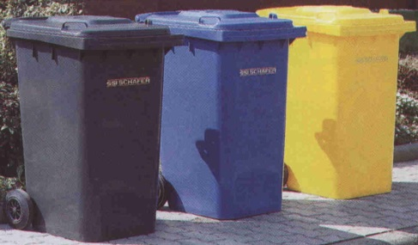
Review of the draft WM chapters
Repeat: Collection: Some key figures
Container collection (from households)
Container gross weight
Bulk density = pouring density * filling level
Limiting factors
working time
human power (labor protection, OHS provisions)
example: 120 l, 150 kg/m³ Bulk density = 18 kg per container,
for 900 container per shift = 16 t !!
Container size [in l] | Bulk density [in kg/m³] min. max.
MGB 120 / 240 | 100 | 160
MGB 770 / 1100 | 100 | 120
Container size [in l] | Emptyings [container per day shift] min. max. average
MGB 120 / 240 | 700 | 1,100 | 900
MGB 770 / 1100 | 100 | 300 | 150

Slide 20
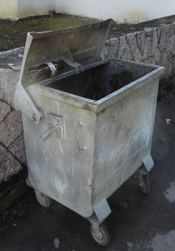
Review of the draft WM chapters
Repeat: Planning advice: Recommendations for container settings
Container provision (approximation of needs)
Container capacities for household collection
most common container of 770 to 1100 litres
Limiting factor
volume
usable (=net) volume is determined by bulk density
bulk density normally ranges between 100-200 kg/m³
Example: 1100 l, 100 kg/m³ Bulk density = 110 kg per container
one person in project region generates about 0.7 kg of waste per day i.e. waste from about 150 persons would fill the container within 24 h
Has this been applied? Need more calculation help?

Slide 21
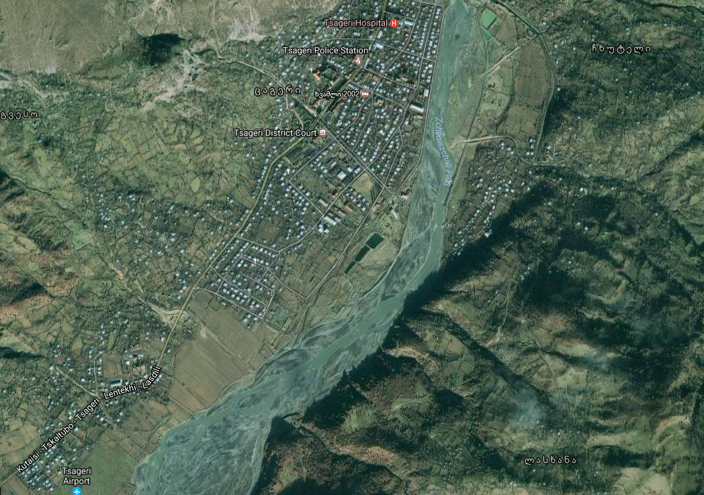
Review of the draft WM chapters
Repeat: Basic decisions and options (I)
Optimize collection in already connected areas and/or extend to other areas
70% of inhabitants
Decs.: add container to intensify collection
Res.: 60% >> 80%
85% of inhabitants
Decs.: provide container
Res.: 60% >> 80%
85% of inhabitants
Decs.: provide container
Res.: 60% >> 85%
What options have been discussed/decisions been made?

Slide 22
What is expected by the MoENRP after the training
WM plans that conform to the basic requirements (Art. 13 WC)
➔ carefully check content and structure
Justified and logic figures (current/forecasted)
➔ Methodologies/mechanisms/data sources used for
calculation/estimates!!
Maps, graphs and tables for the various figures,
e.g. map/table for the current and future distribution of container
➔ Consolidate/reduce running text
Commitments on tariff introduction and fee collection, not
actually the details who has to pay how much

Slide 23
Integrated Solid Waste Management Kutaisi
– Accompanying Technical Training –
8th Training
“Municipal Waste Management Planning“
Planning support
-separate collection, amenity sites-
Jan Reichenbach
Expert Solid Waste Management

Slide 24
Amenity sites/centres
are publicly accessible waste management facilities specially set up to complement the established infrastructure for waste collection.
are usually operated under the responsibility and surveillance (staffed sites) of municipalities or associations [that municipalities have formed for waste management purposes] and have wider service functions that may include
take back
caretaking of various materials (reception, storage, pre-sorting)
charging of fees (payment collection)
public information/education points

Slide 25
Amenity sites/centres
Services offered
Accepts source separated materials
the municipality has an interest and the capacities to easily process or market them by itself (e.g. scrap metal, green waste)
of which larger amounts first need to be aggregated for efficient transportation and/or marketing
for which commercial byers or PRO wish to use (and remunerate) a collection infrastructure and the supervision/pre-sorting service of the municipality (e.g. plastic bottles, WEEE)
Accepts ‘special’ wastes (against or without payment)
that require special precaution/care due to their hazardous characteristics
which are otherwise difficult to collect
Accepts miscellaneous waste materials (usually against payment)
citizens want to/need to get rid of outside regular collection schedules or in quantities which are not manageable over ordinary collection devices (e.g. bulky waste, C&D waste)

Slide 26
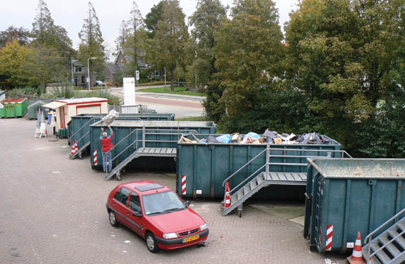
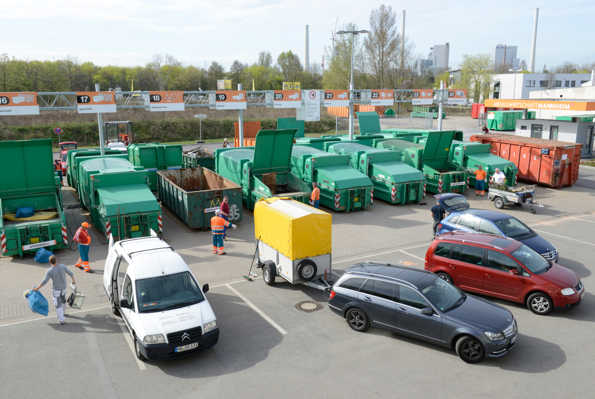
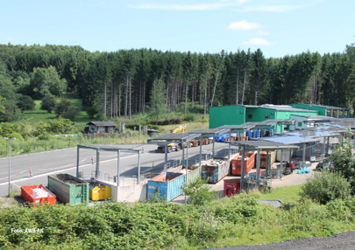
Amenity sites/centres
Must the investment be large?
Rule of thumb:
1 site per >20,000 persons

Slide 27
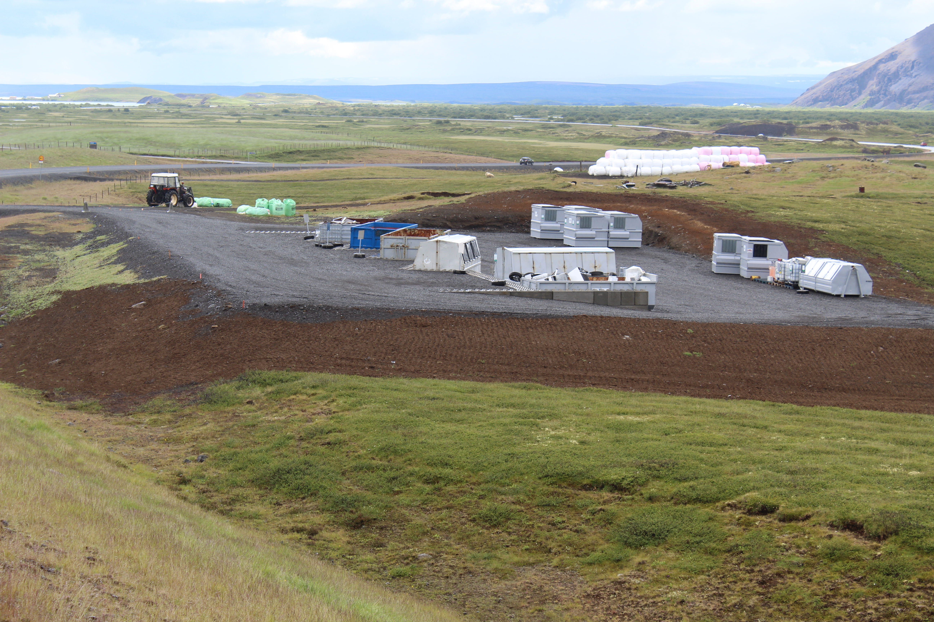
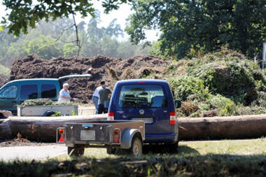
Amenity sites/centres
The investment must not be large at all!
A big advantage comes from the possibility for modular development
Estimates:
Construction investment in the range of GEL 100,000
Annual site maintenance in the range of GEL 3,000
Low additional staff costs

Slide 28
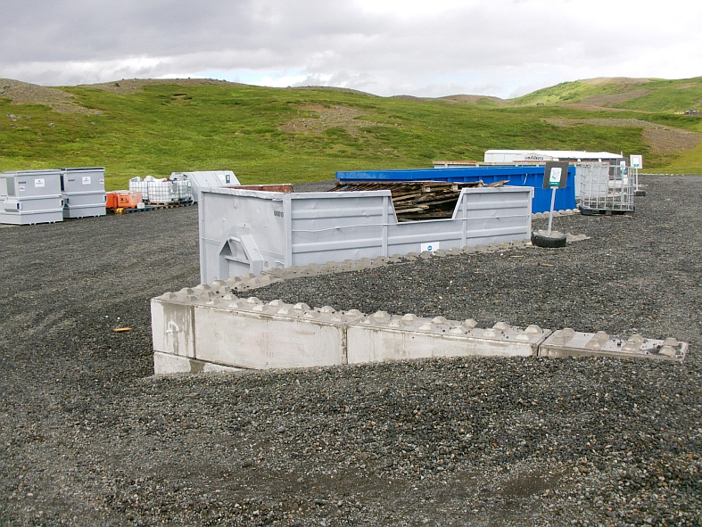
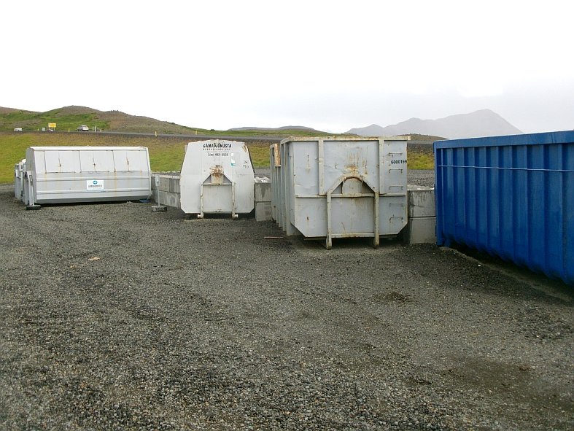
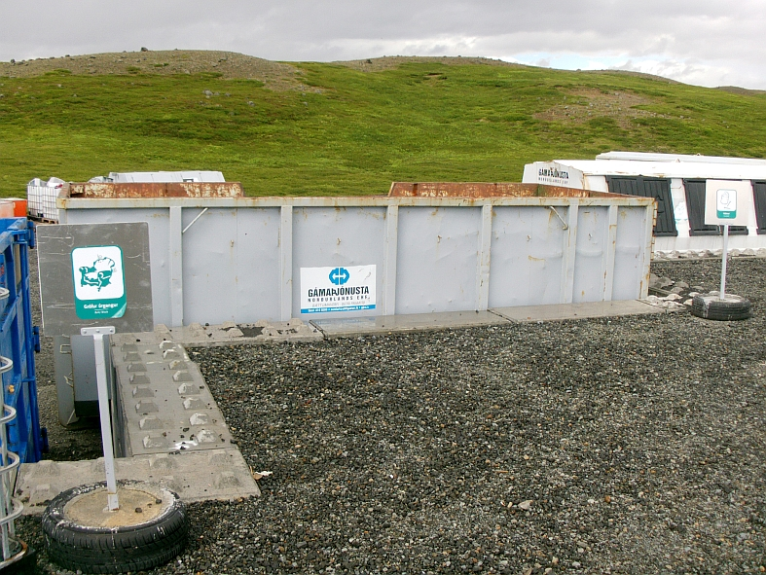
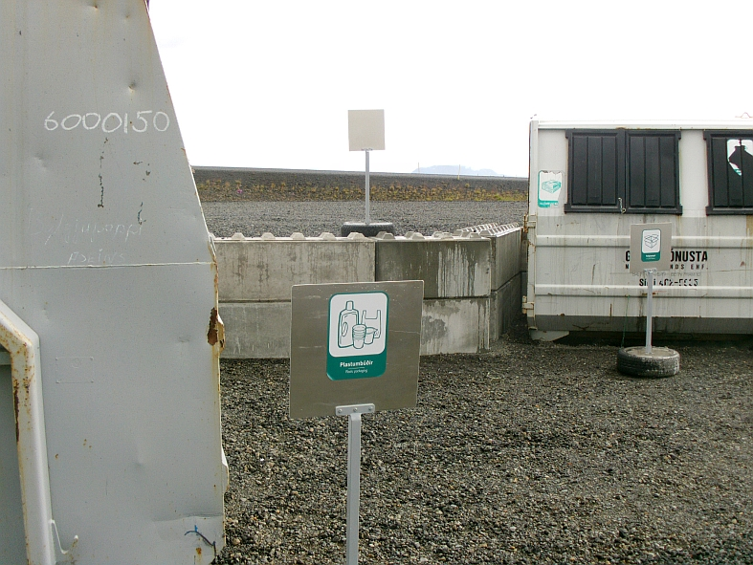
Amenity sites/centres

Slide 29
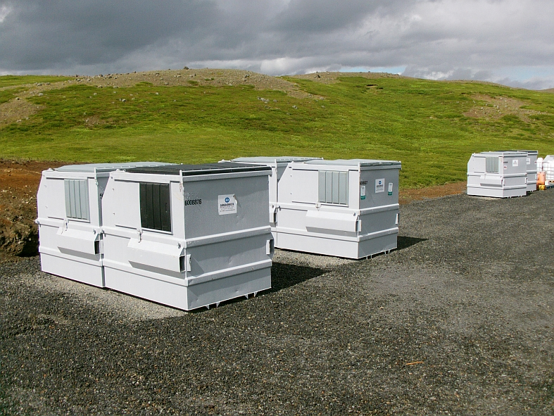
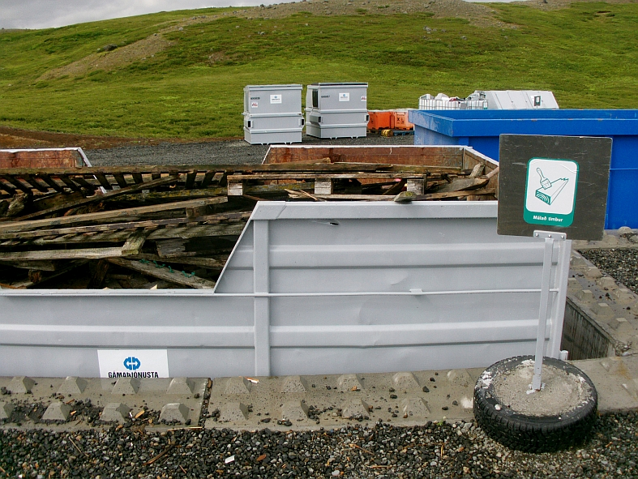
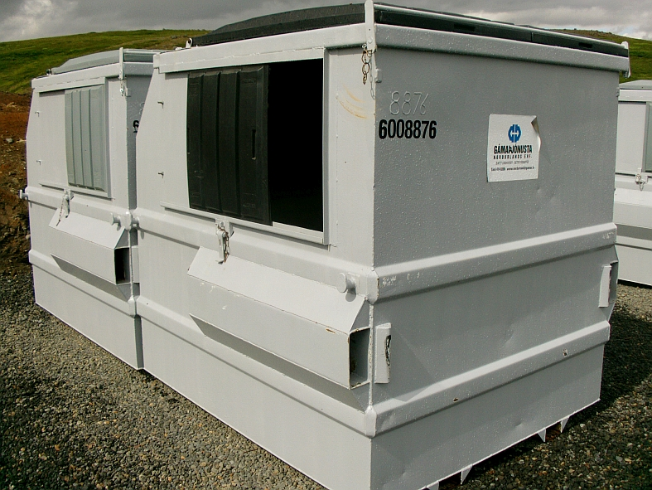
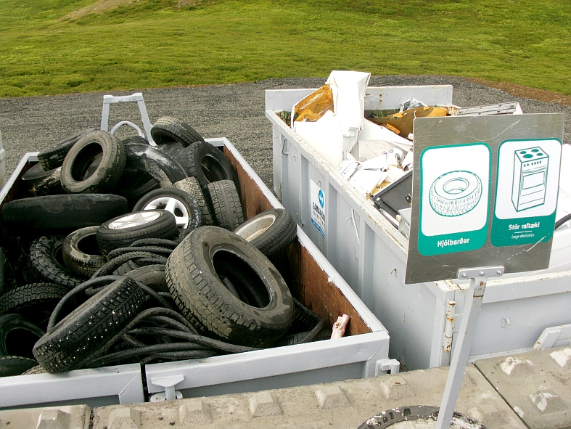
Amenity sites/centres

Slide 30
Amenity sites/centres
Where to set them up?
In or near the dense urban areas
Covering a high number of the population
Possible combination with spaces/yards used for SWM purposes already
Space saved for multiple containers set out (incl. the traffic to empty them)
Serving both households and commercial entities at the same time
Short ways for the users
As a joint investment of municipalities in a place conveniently located for all
Optimized investment
Big area coverage

Slide 31
Amenity sites/centres
Solutions in the Imereti/Racha area
Together with transfer stations
Chiatura (also covering Sachkhere area)
Tsageri (also covering Lentekhi area)
Samtredia (also covering Khoni and Vani area)
Ambrolauri (also covering Oni area)
In or near the dense urban areas
Kutaisi
any other Municipality proper/centre where deemed…
…helpful to support collection coverage
…necessary due to the too long distance to next available site (e.g. Terjola in a joint solution with Tkibuli, Zestaponi in a joint solution with Kharagauli)
In all cases with sufficient access, staffing and site protection ( i.e. fenced, lockable containers) ➔ former dumpsites might be an option

Slide 32
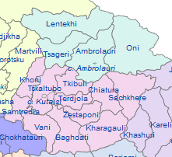
Siting of WM facilities
Central regional landfill
Planned transfer stations w./
option to host amenity centre
Useful locations for further
amenity centres

Slide 33
Integrated Solid Waste Management Kutaisi
– Accompanying Technical Training –
8th Training
“Municipal Waste Management Planning“
Conclusions
and follow up program
René Boesten, Jan Reichenbach
Foreign Expert Team

Slide 34
Main issues/steps until December deadline
Document finalization
when?
what further support is needed?
Consultation with neighbors and the public
when and how?
Municipal approval procedure
when?
→ Submission to MoENRP
Let’s hear and discuss your plans or ideas

Slide 35
End of the centralized training sessions
8 joint trainings within 10 months
about XX different municipal staff in total attended at least one training session
more than 25 consultative visits in the individual municipalities so far realized
a certain number of such visits will still be undertaken in November and December
expert support will continue in a limited extent in the frame of the implementation of selected MWM pilots
Thanks for your attention, active participation and all
the interesting insights and discussions shared.
We wish you best of luck in your important job and any of your efforts to get MWM successfully realized in your community

