Slide 1
Integrated Solid Waste Management Kutaisi
– Accompanying Technical Training –
Sustainability in composting projects
Compost quality and other issues
Training seminar for
Municipalities & Services responsible for managing municipal waste (MSW) in the
Imereti and Racha-Lechkhumi-Kmevo Svaneti region of Georgia
with a particular focus on the mountainous municipalities
Jan Reichenbach
INTECUS GmbH, AMC Expert team Solid Waste Management

Slide 2
Ensuring sustainability
Key sustainability aspects in composting projects
Public acceptance
Proper siting approach
Well-organized collection (→ input quality and quantities)
High operational standards and safety
Public benefits (→ supplies of compost, transparent transfer of savings)
Market acceptance
Existence of offtakers
Product quality/safety
Preparedness to learn and adjust
Compost quality is decisive for the success of a composting initiative!
It requires utmost attention from its very beginning.

Slide 3
Public acceptance
Proper siting
has to include:
land and infrastructural suitability
distance to neighborhood
transportation routes
public engagement process
Well-organized collection
has to take account of:
convenience issues
minimum nuisance
proper information
certain regularity (service and supply)
High operational standards and safety
see corresponding information provided on composting practice & quality issues
Public participation
must involve:
a sharing mechanism (information, product, financial)

Slide 4
Market acceptance
Input determines output
Samples from composting
German quality assurance BGK
Proposed
Syrian standard
Unprocessed mixed household waste (MHW)
Biodegradable part separated from mixed household waste
Processed MHW
Source-separated biodeg. w
Quality 1
Quality 2
Lead
Cadmium
Chromium
Copper
Nickel
Mercury
Zinc
Safe compost can be produced from source separated biodegradable material only!

Slide 5
Quality features
Product quality = value of compost + adherence to precautionary criteria
Value indicators
Rotting degree
(state of material decomposition)
Bulk density
Salt content/ pH-value
Concentration in plant nutrients
Carbonats
Organic matter content
Environmental safety/acceptance
Material hygiene
(presence of salmonellae)
Viable weeds/seeds
Potential toxic substances
(heavy metals)
Other undesired matter
Degree of visible pollution

Slide 6
Quality standards
Environmental safety
German RAL-standard (limiting values)
EU-level recommendation
Parameter | Class 1 | Class 2
Impurities (glass, metals, plastics (%) | <0.5 | 0.5
Lead mg/kg dm | 100 | 150
Cadmium mg/kg dm | 1.0 | 1.5
Chromium mg/kg dm | 70 | 100
Copper mg/kg dm | 70 | 100
Nickel mg/kg dm | 35 | 50
Mercury (mg/kg dm | 0.7 | 1.0
Zinc mg/kg dm | 300 | 400
Viable seeds and sprouting plant parts | 2 seeds/l
Parameter | EC comm. 834/2007 | EU eco-label
Impurities (glass, metals, plastics (%) | - | <0.5
Lead mg/kg dm | 45 | 100
Cadmium mg/kg dm | 0.7 | 1.0
Chromium mg/kg dm | 70 | 100
Copper mg/kg dm | 70 | 100
Nickel mg/kg dm | 25 | 50
Mercury (mg/kg dm | 0.4 | 1.0
Zinc mg/kg dm | 200 | 300

Slide 7
Quality standards
Compost value
Example: Provisions as per German quality assurance
Quality criteria | Parameter | Applicable requirements
Organic matter | Loss of ignition (mass-%) | >15 fresh c. / >30 mature c.
Dry matter | Dry matter (mass-%) | >55
Nutrients | N, P₂O₅, K₂O, MgO, S (%) | to be declared
Alkaline effective matter | CaO (%) | to be declared
Nitrogen soluble | NH₄₋, NO₃₋ (mg/l dm) | to be declared
Salt content | (g/l dm) | to be declared
pH-value |  | to be declared
Rotting degree | Degree centigrade | 60-40 fresh c. / <40 mature c.

Slide 8
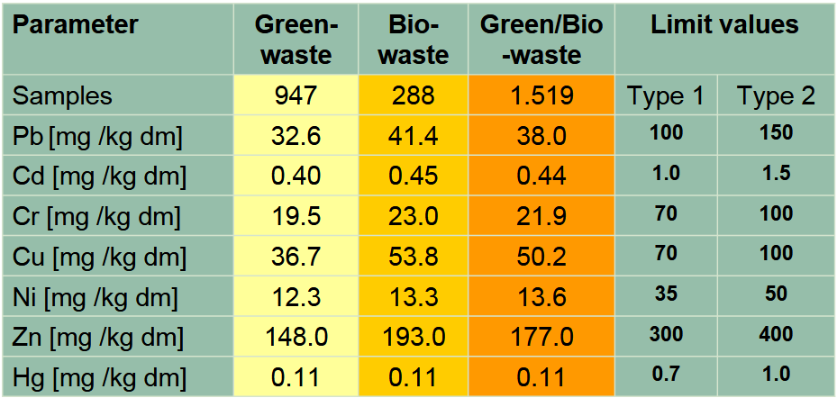

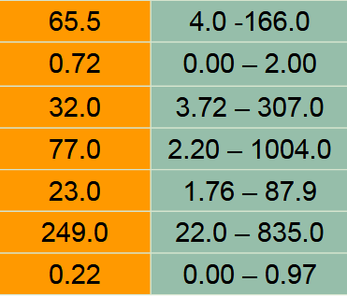
Quality standards
Limiting values and reality
Example: Results of German quality assurance monitoring

Slide 9
Securing safety of compost/compost use @ Process stage
1. Stipulations on operating conditions
Requirements to make sure sanitization/product hygiene
Composting facilities ensure material is exposed to 55 °C for two weeks or 65°C for one week (60°C in closed plants) [e.g. via legislation, German BioAbfV]
2. Process Supervision
Continuous temperature management; every working day or automatically in three representatives zones
3. Direct Process Validation
Dumping and retrieval of test and indicator organisms
- Human and veterinary hygienic aspects (salmonellae)
- Phyto hygienic aspects (tobacco mosaic virus, clubroot (plasmodiophora brassicae), tomato seed
4. Final Product Analysis
Continous examinations of the final product
- Salmonellae
- Germinative seeds and reproducible plant parts

Slide 10
Securing safety of compost/compost use @ application
Stipulations on application requirements
Example: German practice
Total (dry matter) amount applied per hectare within a period of three years shall not exceed:
Class 1 compost: 30 tons
Class 2 compost: 20 tons
Further restrictions: Treated separately collected biowaste from households is not allowed for application on permanent grassland.
Further ways to get precautionary regulations for compost use covered:
Fertilizer regulation -relevant for agriculture and gardening
Soil protection regulations
Regulation on Organic Farming

Slide 11
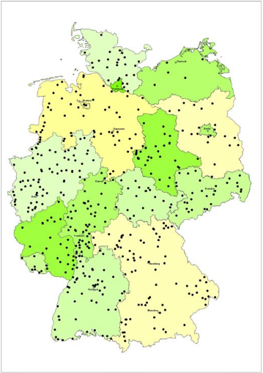
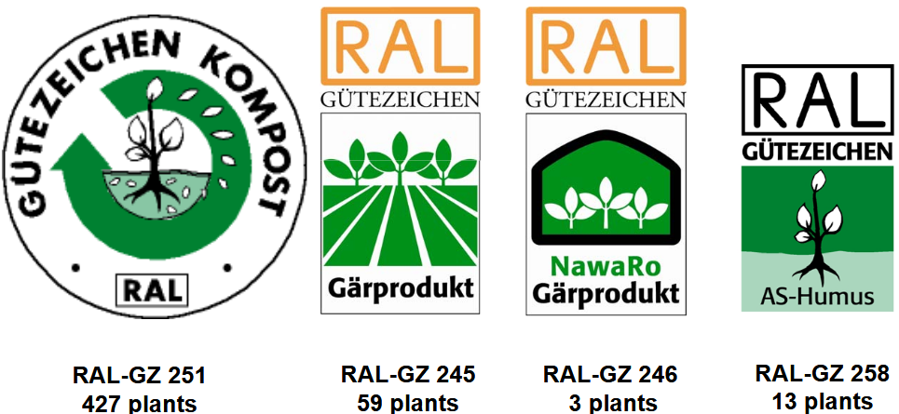
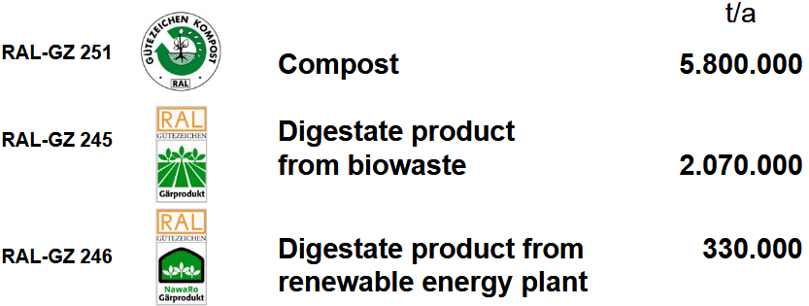
Institutionalisation of quality assurance
For example by installation of a self-obligatory measure of the industry which legal authorities formally recognize
In Germany since 1989: Quality Assurance Organisation for Compost Bundesgütegemeinschaft Kompost e.V. (BGK), established RAL quality assurance for compost (1991); RAL-quality labels identify a standardised and regularly checked product
Source: BGK, 2009
70 % of the compost produced in Germany gets the quality label RAL-GZ 251

Slide 12
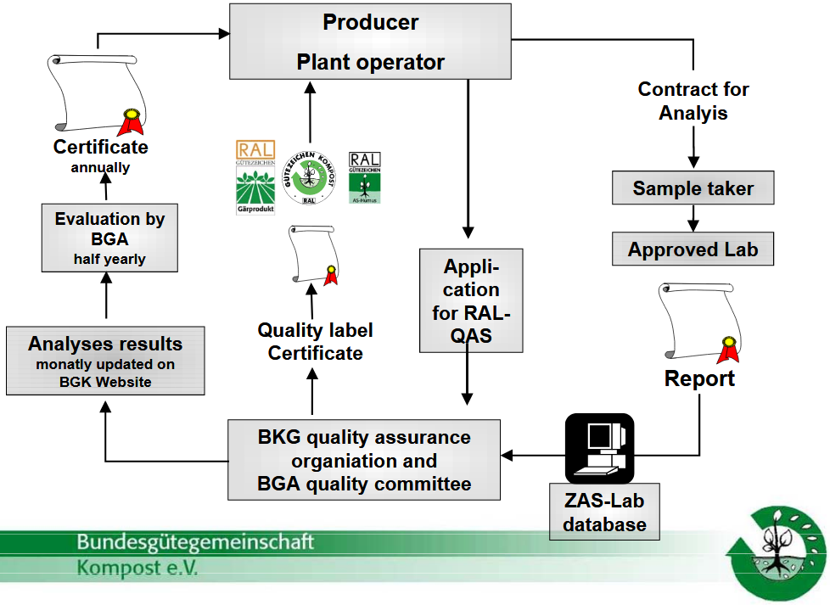
Objectives of the institutionalisation
Market acceptance / User safety
Specification of products with a guaranteed homogenous quality
Guarantee for a successful use of the products
Promotion
Enhancement of product quality and operation quality (increased reputation)
Promotion of the re-use of waste
"from waste to product“ (SWM support)
Safety and Ease for Operators
Deregulation
Recognition of certified products by legal authorities, in agricultural systems and by food processing industry
Source: BGK, 2009

Slide 13
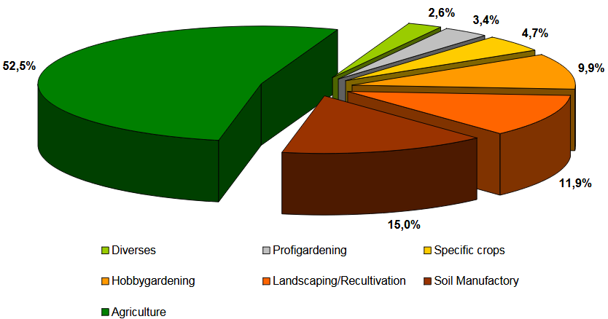
Compost market
Offtakers structure for facility produced compost
Example: RAL-labelled compost products in Germany
Source: BGK, 2009

Slide 14
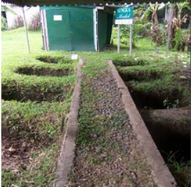
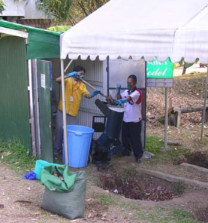
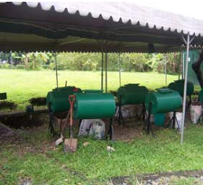
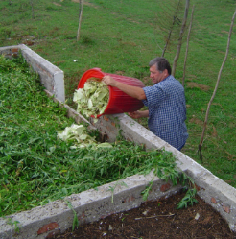
Preparedness to learn and adjust
The importance of piloting!
Decentralized aerobic composting of urban solid waste: Some lessons learned from Asian-EU Co-operative Research. Global NEST Journal, Vol 12, No 4, pp 343-351, 2010
Waste Composting in Kutaisi
funded by Royal Netherlands Embassy in Georgia, 1.09.2006-1.09.2007, GEL 16,890

Slide 15
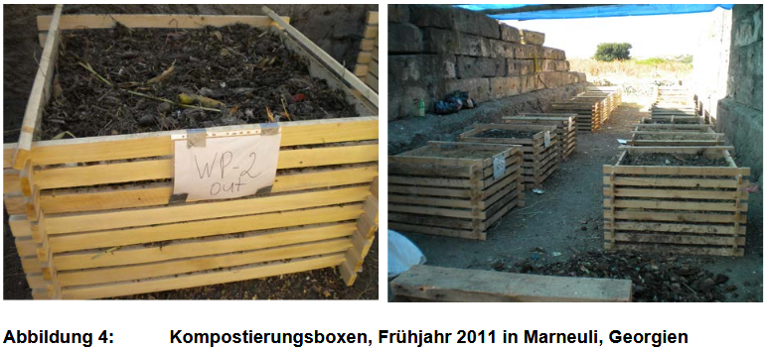
Preparedness to learn and adjust
Lessons learned ?
Sustainable use of biogenous household waste through aerobic treatment of separately collected organic waste and the application of compost in South Caucasian agriculture.
Nikolas Zöller, Faculty of Organic Agricultural Sciences, University of Kassel, Witzenhausen, 2017

Slide 16
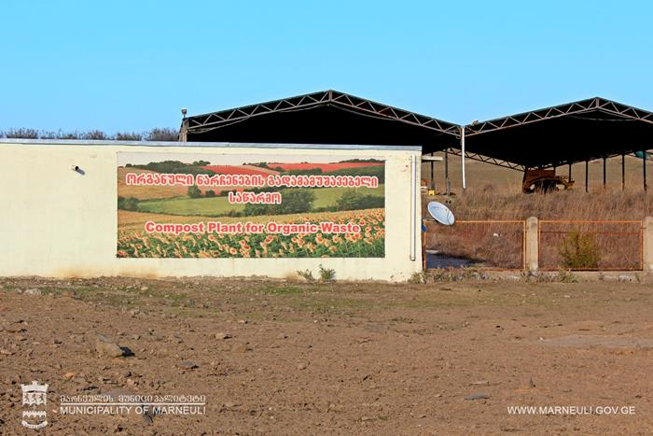
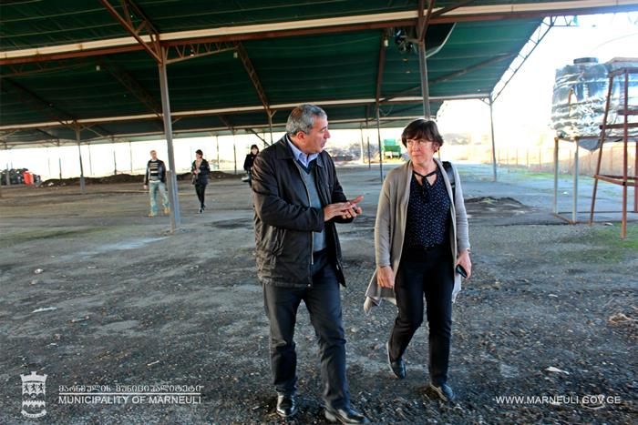
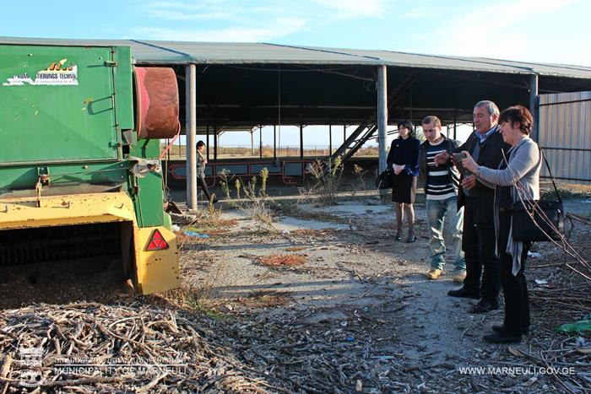
Preparedness to learn and adjust
Lessons learned ?
10 ნოემ 2016
http://www.marneuli.gov.ge/marneulis-shesaxeb/siaxleebi1/1331-chexi-eqspertis-morigi-viziti-marneulshi.html

Slide 17
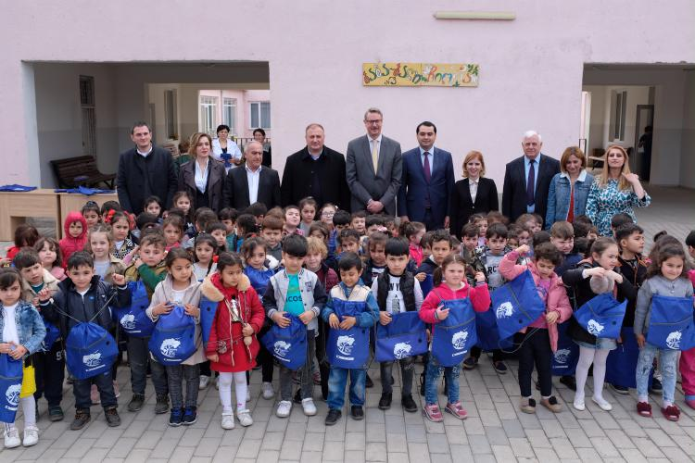
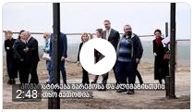
Preparedness to learn and adjust
Its worth figuring out
EU and Government launch pilot green waste separation, collection and recycling project in Marneuli. Pilot will demonstrate how to utilise the green waste that fills 50% of regional landfills and help diminish production of Green House Gases https://eeas.europa.eu/delegations/georgia/59702/node/59702_lv
https://www.facebook.com/europeanunioningeorgia/videos/marneuli-waste-project/2067451053551138/

